Slide 1
Standardisation of the management of International Criminality within UK policing
Dr Jeremy Pearson
University of Sunderland

Slide 2
Context
19% of all arrests within the UK are Foreign National Offenders (FNOs).
17% of the UK prison population are FNOs.
30% of mapped Organised Crime Groups (OCGs) within the UK involve FNOs.
International criminals constantly seeking new opportunities.

Slide 3
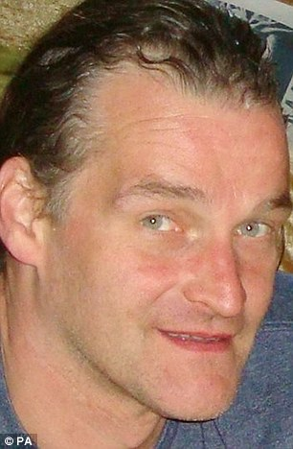
Arnis Zalkalns
41 year old Latvian builder living in London.
Previous conviction for a domestic related murder in Latvia.
Arrested in the UK in 2009 for indecently assaulting a 14-year old girl.
In 2014, sexually assaulted and murdered Alice Gross, a 14-year old girl.
Police procedural failings in previous management of Zalkalns.

Slide 4
Research Question
Can the introduction of national guidance to UK police forces improve outcomes around the management of International Criminality within the UK?
Work to introduce national guidance was endorsed and supported by the:
National Police Chiefs Council (NPCC)
The Home Office
ACPO Criminal Records Office (ACRO)
A pragmatic research approach was taken, using mixed methods, supported by the University of Sunderland.

Slide 5
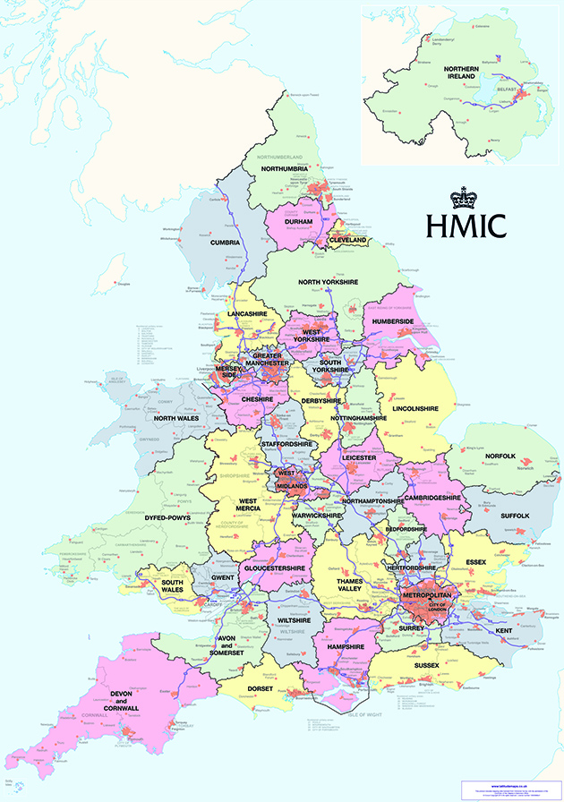
Desk Based Analysis
2016-17 Home Office sponsored national programme of force visits.
Force reports contained qualitative and quantitative data.
Analysis indicated huge inconsistencies in the quality of response.
No understanding of the size and scale of the FNO threat.
No consistency in classification of a FNO.
Common theme was lack of guidance for officers.

Slide 6
Survey
2 cohorts of officers surveyed using electronic questionnaires with participation being entirely voluntary.
Groups surveyed were frontline officers and International Liaison Officers (ILOs) who could be classed as subject matter experts.
Forces chosen for distribution of surveys to frontline officers, included those located in both urban and rural locations. A total of 639 responses were received from this cohort.
ILOs in each of the 43 forces were surveyed with 72 responses received.

Slide 7
Survey Findings
Frontline officers reported significant lack of knowledge and understanding with only 9% claiming a good level of knowledge.
Even among subject matter experts, 32% admitted to significant gaps in their understanding and knowledge.
Officers identified a number of areas of operational policing where they lacked understanding with only 16% of frontline officers claiming to be confident when dealing with FNOs.
Over half of officers stated that they had no point of reference to guide them in managing encounters with FNOs.

Slide 8
APP National Guidance
APP guidance completed and published in 2018.
Published on the College of Policing website and available as an operational resource and point of reference to over 120,00 police officers.
Brexit contingency guidance prepared pending the result of EU exit negotiations.
Definition of a Foreign National Offender.
‘A Foreign National Offender is a person known or suspected of involvement in criminality, who cannot be confirmed as having been a British citizen at birth’.

Slide 9
Outcomes
Development of key performance indicators (KPIs) and a robust performance regime.
Increased awareness and understanding of the threat.
26% increase in numbers of foreign conviction requests.
Huge increases in Interpol usage.
International Criminality being adopted as a strategic priority in numerous forces.
Officers processing FNOs with the same rigour as domestic criminals.

Slide 10
Final thoughts
Understand the threat.
Support officers.
Remain agile.
Whole system approach.
Notes:
Conduct crime analysis to understand size and scale of threat.
Provide guidance and other resources to staff – provide them tools to be effective
Criminals are resourceful – remain watchful.
Use IE & other agencies – sex offender in community example.

