Slide 1
A Pedagogy of vulnerability for relational practice
Kate Duffy
University of Sunderland, UK
Notes:
I lead the Education Studies UG prgramme at the university of Sunderland in NE England; the area has greater deprivation than other areas of the UK. The university, as a civic university which draws most of its students from the local region and is focused upon raising aspirations and widening access and participation to higher education to transform the region and lives.
The Education Studies programme is relatively small with 100 students who go on to train as teachers and other positions in and around the field of education.

Slide 2
Purpose of this presentation
To share my research journey with you
To resonate with your experiences of relational practice
To explore relational practice as a pedagogy of vulnerability
To illuminate the value that vulnerability can have in relation to transformative education
Notes:
I completed my Phd in Education in 2019 while working full time in the school of education. The aim of my presentation today is to…

Slide 3
Sea Swim Triathlon
Notes:
My phd closes with a recollection of sea swim triathlon that I completed and I see this as a metaphor for a pedagogy of vulnerability.

Slide 4
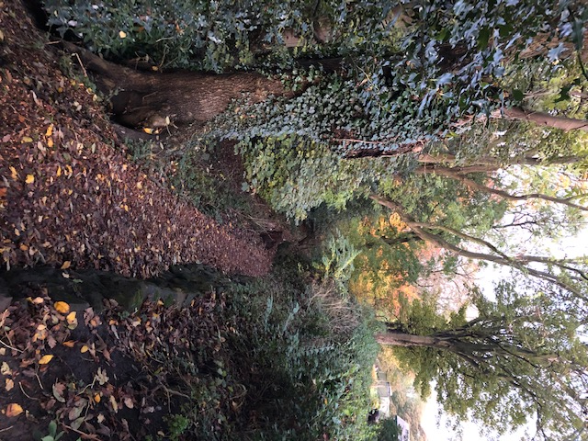
The path to take…
I wanted to know…
how I perceived moral practice and agency in HE
And
how I dealt with moral choices and conflicts
Notes:
Back to the start - my phd began with these two questions. Up until this point my research had been about others in education and their practice and their understanding for their work – I now felt it was important that I turned these tables on myself and asked myself questions about my practice to gain a deeper understanding of what I did… ultimately, my early question was ‘how can I know if I am good teacher?
This overarching question became ‘What is good practice to me? – how do I perceive it? - and what capacity/agency do I feel I have to undertake it? ; AND when I have to make choices or deal with tricky aspects of education practice…what are the contexts of these dilemmas and what do I do? Which path do I take and what motivates my decisions and actions?

Slide 5
Vulnerability as a dimension of the research paradigm
The methodology for my PhD was (and continues to be) autoethnographic (Ellis & Bochner 2016; Chang 2008).
My aim was (and is) not to generalise but to be relatable, to understand rather than define
to open up dialogue and self reflection not only on personal practice but on the systems, cultures of teaching in HE (and beyond),
using my dairies as the primary data collection and artefacts such as emails from colleagues and students
Notes:
As I wanted to gain a deeper understanding of my own practice, I had to adopt auto ethnography as the methodology. Education is overwhelmed by the ‘this is how to do it..’ text book/tool box/off the shelf etc – to first of all I was writing this for me, secondly, I didn’t want my work to tell people how to ‘be’ good teachers (whatever that meant); I wanted my experience to resonate with, and be understood by, other educators. They might ask the same questions of themselves. Most importantly, I wanted to try to capture the messiness of practice and the complexity of ‘being’ a practitioner in education.
Autoethnography afforded me this opportunity – to be self reflective and open in the context of the systems and cultures and relations I worked within – initially it felt that it was the most ethical way to do my research – it was fair and right – it was later on into the process that I fully grasped how vulnerable and risky the approach is and was.
AE views the researcher as the primary participant in the study and I chose to use my diary as the main data collection method.

Slide 6
I learnt that…
…moral practice for me, was relational practice and required me to embrace vulnerability
Notes:
What I found after analysing my diaries …

Slide 7
Analysis
37 Diary entries, collected over the course of an academic year
Adopted Anderson’s (2006) analytic view of autoethnography to code the diaries
Emerging categories of, Connection; Care; discomfort; Blame
Thematic narrative analysis (Riessman, 2008) to place the categories in context to reveal themes
Notes:
There were two stages of analysis; the first deconstructed the diaries entries using a traditional analytic process. However, the process of deconstruction removed the context and the situation that these categories emerged in – this is counter to the aim of autoethnography. The process of going in close but pulling back to reveal cultural and social influences enabled the theme to emerge

Slide 8
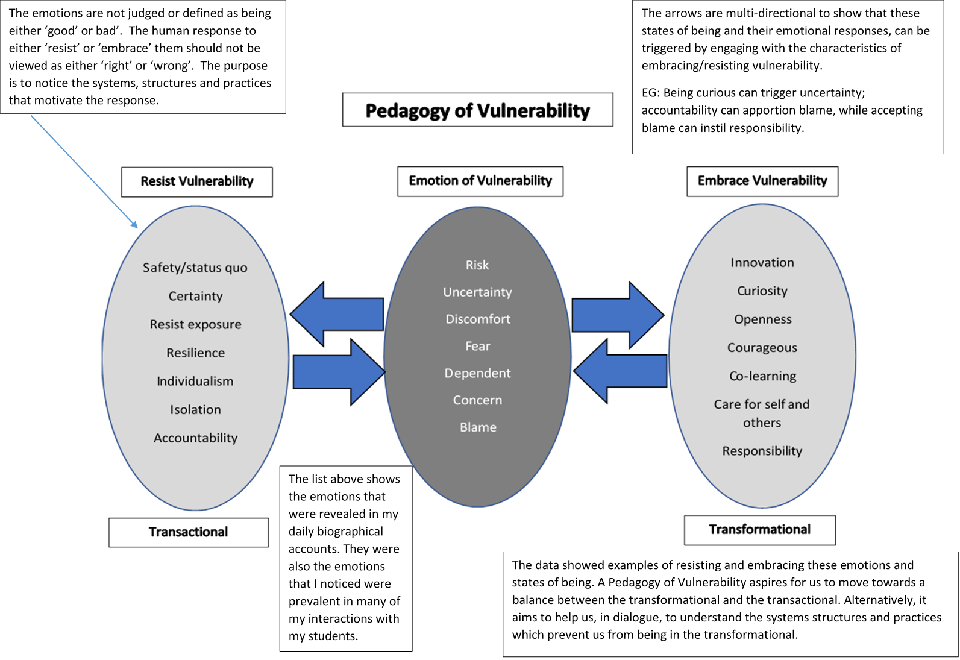
Notes:
The theme revealed my practice as a pedagogy of vulnerability.
In the centre, are the emotions that were prevalent in my diaries – in my day to day interactions, roles and tasks, practice. Not only just of me, but many of my students too.
The left - describes my response to the emotions where I was avoiding, supressing and resisting them – eg not wanting to try something new in my practice for fear of it failing and being blamed for that. For my students, I noticed that they might resist pedagogies of discomfort where they could be challenged and required to think differently. This resulted in the experiences on the left.
However, when I activity embraced, searched for or created the opportunity for the emotions inn the centre, our experiences became more transformative – with curiosity, openness, innovation, relationships formed, learning was more expansive and memorable for both students and me.
This diagram is not to show that one is better than the other (although I do want to make more opportunities for transformative situations). I use it as a way of reflecting upon the situation I am in, how I feel about it and how I am responding to it. Ultimately it to understand the situation, systems and cultures and what effect they have upon us rather than asking the person to supress their natural feelings.

Slide 9
Embracing Vulnerability
Recognises that vulnerability is a human condition (Fineman, 2008)
Challenges the neoliberal view that vulnerability is weakness (Butler, 2016; Vlieghe 2010)
To raise our consciousness of the strength in vulnerability rather than being ashamed of it (Brantmeier, 2013, 2020; Butler 2016; Brown 2010)
To resit the desire to control through predictability (Bracke, 2016)
Notes:
When we are embracing vulnerability, we are recognising that that we are all vulnerable at some point – it is something that we do have in common - to deny this is to deny our humanity.
To see it as a weakness and something not to show, not to enter into, to be demonised or shamed by it is something Judith butler Brene Brown and Edward brantmeier are advocating that we should challenge

Slide 10
Pedagogy of Vulnerability
Adopting teaching and learning strategies which encourage inquiry, curiosity, comfort in uncertainty
Transformation is uncomfortable.
We are not meant to do this in isolation – we need to form connections and relationships which support and care for us.
Recognising that to fully care for the learners is to connect the pastoral care closely to the academic support will mean a reversal of the current trend to separate them.

Slide 11
Wider implications for practice
Pedagogy of Vulnerability is an ‘overlay’ to support reflection of practice, cultures, systems and structures
Moral practice in HE is relational
I want to increase my attention to teaching strategies which foster the establishment and maintenance of positive relationships between academics, teachers and learners and between learners.
I want to provide a counter challenge to the individualistic and outcome-biased view of curriculum.
Recognise that practise which values human interaction can model the ways we want our learners to be in their world.

Slide 12
Then the pandemic hits…
A panic to find ways to stay connected
Looking after each other
Expectation to take personal decisions on the basis of putting others (strangers) first
Making sense of uncertainty

Slide 13
During the pandemic
…create a safe space online for them to be open when sessions are to be recorded
…ensure all voices are heard when we only speak one at a time
…encourage them to disagree with me or share their uncertainty when we are on mute
…notice when a student is thinking about their response and needs more time and encouragement to get there – when they need to turn their video off
Notes:
The pandemic hit and all of the dilemmas I had work really hard to maintain a pedagogy of vulnerability

Slide 14
During the pandemic
…encourage them to care for each other when they haven’t met
…limit my voice and experience as the dominant one so their diversity and knowledge can be shared
…encourage them to want to do things differently when they crave to go back to normal
…encourage them to take risks and challenge themselves

Slide 15
Implications & limitations
Dominance of Neo-liberal values on policy, practice and management
Curricular design; isolated modules; fixed semester planning;
Spaces and time to allow relations to develop
Notes:
Post pandemic the promises of a new normal – eg what will you not want to go back to – are all forgotten. The implications I raised a the end of my phd are even more enhanced now.
Greater control and measurement – accountability, fear.
Narrowed curricula for student health appears to be remaining
Leaving less time to allow relations to develop – more pastoral aspects ‘outsourced’ (perhaps rightly so – eg mental health teams are larger than most teaching teams)

Slide 16
Implications & limitations
Pedagogies of discomfort (Zembylas 2017) – fear and resistance can stop learning and connections
The culture of ‘fear of failure’ for both educators and students.
I may ‘wish’ to engage, more often than not, with a pedagogy of [mutual] vulnerability, however the students need much more reasurrance to get there.
Notes:
Student focus is more transactional than ever before
Uncertainty is not an option for many

Slide 17
References
Anderson L (2006). Analytic auto ethnography. Journal of contemporary ethnography. Vol 35 No4, pp 373-395
Bracke (2016) Vulnerability in Resistance. USA. Duke University Press.
Brantmeier E J (2013) Pedagogy of vulnerability: Definitions, assumptions, and applications. In Lin et al (2013) Re-envisioning Higher Education: embodied Pathways to wisdom and transformation.
Brantmeier E J, McKenna, M K (Eds) (2020). Pedagogy of Vulnerability. Charlotte NC. Information Age Publishing
Brown (2012) Daring Greatly: How the courage to be vulnerable transforms the way we live, love, parent and lead. USA. Gotham Books
Butler, J Gambetti, Z, Sasby, L (eds) (2016). Vulnerability in Resistance. USA. Duke University Press.
Fineman, M A (2008). The Vulnerable Subject. Anchoring Equality in the Human Condition. Yale Journal of Law and Feminism. Vol 20, issue 1, article 2. Available at [http://digitalcommons.law.yale.edu/yjlf/vol20/iss/2
Riessman, C K (2008). Narrative methods for the Human Sciences. London. Sage.
Rich, P (2018). What can we Learn from Vulnerability Theory? Honors Projects. 352. [available at https://scholarworks.gbsu.edu/honorsprojects/352. ]
Vlieghe, J (2010) Judith Butler and the Public Dimension of the Body: Education, Critique and Corporeal Vulnerability. Journal of philosophy of Education GB. Wiley Online Library.
Zembylas, M (2017). Practicing an ethic of discomfort as an ethic of care in higher education teaching. Critical studies in teaching and learning. Vol.5, No.1 (2017): pp. 1-17
Notes:
Option 1 template. Use black text when using this page.

