Slide 1
On the Same Side: reimagining educational evaluation and improvement for a more equitable world Comparative International Education Society Conference February 22nd 2023 Washington DC
Professor Maggie Gregson and Daniel Gregson
University of Sunderland
maggie.gregson@sunderland.ac.uk
daniel.gregson@sunderland.ac.uk

Slide 2
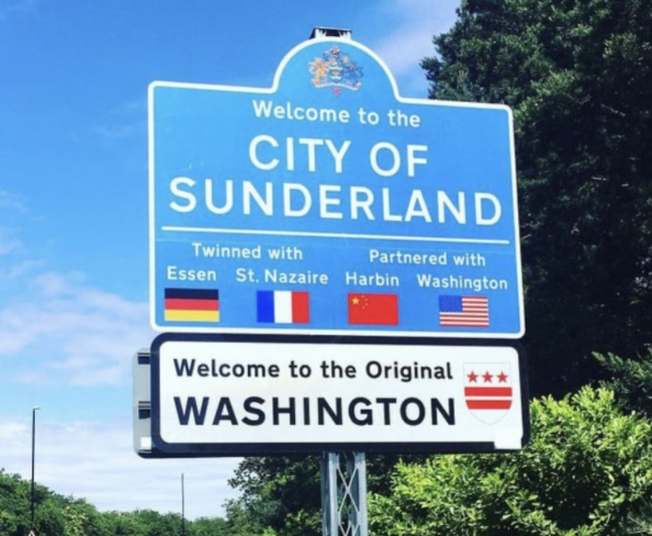
Sunderland University : A lot closer than you think…!
A sign for the city of sunderland and it’s neighbourhood… Washington!
Washington Hall, George Washington’s ancestral family home
Notes:
Good afternoon I’m Maggie Gregson from the University of Sunderland. I’m here with my colleague Daniel Gregson (who is also chairing the session).
We’d like to share some findings from our research conducted as part of the national Practitioner Research (PRP) programme funded by the Education and Training Foundation in England
But let me begin with a shout out to Sunderland and its connections to Washington
On the left of this slide you’ll see a sign welcoming visitors to the City of Sunderland which shows that it is twinned with Washington DC so you may wonder what’s the connection ?
On the right is a photograph of Washington Hall …. George Washington’s ancestral family home which is near Sunderland
So Sunderland may be closer to Washington DC than you might think!

Slide 3
Restarting Educational Change and Educational Policy from a Different Set of Organizing Principles
Taking the conference theme in responding to UNESCO’s (2022) rallying call to make good the unfulfilled promise of ensuring the right to high quality education for every child, young person and adult, as our starting point, we suggest that this will require us to restart education policy and models of educational change from a different set of organizing principles which protect, respect and share a concern for education as the pursuit of the common good.
Rethinking education policy and models of educational change will also need to be accompanied by a staged, but unequivocal shift away from the current policy architecture, values and norms which support the long-standing, top-down, technocratic model of educational change and improvement that has dominated the landscape for over 30 years.
In the first part of this presentation, we critically consider currently dominant top-down models of educational change and improvement and the epistemic assumptions upon which they are based. We then present the argument that top-down models of educational change do not work because … for epistemic reasons … they cannot.
In the second part of the presentation we offer (albeit on a small scale) some practical examples from the national Practitioner Research Programme (PRP) in England of what an alternative, more pragmatic and context-attuned model of educational change and improvement might look like in practice
We acknowledge that starting educational policy and models of change from more pragmatic and context-attuned principles will not be easy … but it will nevertheless be necessary… if Education is to make good its promise.

Slide 4
Loosening the Grip of Model of Educational Change Grounded in a Clockwork Universe
A consequence of the current model of educational change and improvement is that quality (what we take to mean by good education) is reduced to blunt measures of performance outputs imposed from the top-down, measured from the outside-in and presented to the public in the forms of competitive league tables.
Policy professionals, education leaders and teachers have become so caught in the grip of this model of educational change and improvement in a system which is preoccupied with technique and where the discourse is framed by the clockwork and instrumental language of “recipes” and “blueprints” for “excellent” teaching makes it difficult to see how the the education system could operate in any way other than it currently does.
What has become increasingly obvious over the past 30 years is that existing models of educational change and improvement have done little to help education to break the link between inequality and poverty or indeed done much to improve the quality of education.
If we accept that we need to rethink existing models of educational change and improvement, then we need to begin the question of …where do we start?

Slide 5
If it was going to work it would have worked by now!
The first point we want to make is that imposing educational change and improvement from the top-down does not and cannot work.Our second point is that currently dominant models of change and improvement cannot work because they are founded upon an incoherent, epistemic masquerade that is fundamentally premised on a misunderstanding of the nature of educational practice (or indeed any practice) and how practice improves
We draw upon the disciplines of philosophy, sociology and psychology through the works of, Dewey (1910, 1933), Sarason (1993), Elliott (2001) Carr (2005), Kemmis (2005), Sennett (2008) and Coffield (2017) among others, to suggest that a first step in this process of moving toward a more pragmatic, inclusive and democratic model of educational change, is to base it upon what we already know about how we as human beings (students, educators, educational researchers, inspectors, policy professionals) and whole systems learn best ...namely in mutual collaboration and cooperation.
Coffield (2017) draws attention to the paradoxical expectation that a model of educational change and improvement that, creates a climate of fear, relies upon fabrications of reality and truth and assumes that teachers and educational leaders will somehow be inspired to improve what they do in the face of the threat of public humiliation … will “work” in practice… is quite absurd.

Slide 6
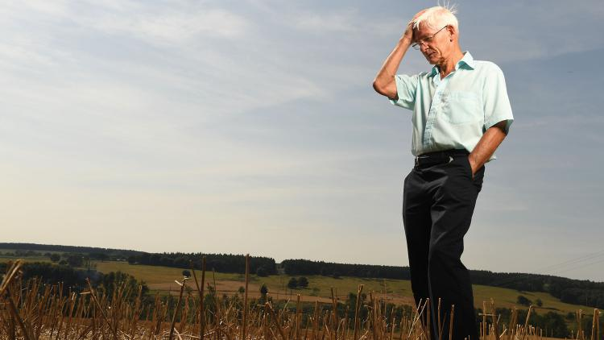
Inspection Failure
Presently inspection fails in its primary objective because it promotes fear rather than improvement – tutors learn little more than how to concoct the most favourable outcome possible. Instead of engaging in genuine dialogue with inspectors, managers feel forced to manipulate data in an attempt to second guess … (educational inspectors’)... ever-changing demands. They become alienated from a process that is more akin to an incubus than a stimulus for change…No one with a statistical imagination can take seriously the accuracy claimed by observers who reduce the complexities of classrooms or workshops to a number between one and four; or the myriad of tasks undertaken by an FE College to a single adjective. Such overweening pretension to exactitude should be discarded
Coffield, TES, February 2017
Professor Frank Coffield
Notes:
Coffield reserves his strongest criticism for the current model of educational change and inspection operating in England … where he argues that
Read the quote
Strong criticism indeed for the current model of educational change in England… however it seems this model might have an even bigger footprint …as Seymour Sarason points out

Slide 7
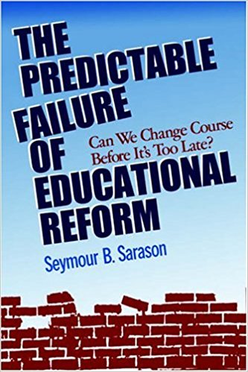
Models of Educational Change and Improvement and the Predictable Failure of Educational Reform : a retrospective review of educational reform in the USA since the 1970s (Sarason, 1998)
Why …have our efforts – and they were many and expensive – met with intractability? Why should we expect that what we will now recommend will be any more effective than our past efforts?
Sarason,1998, p.3
Notes:
‹#›
Writing of models of education change in the USA Sarason invites us to consider…

Slide 8
An Epistemic Masquerade : the Predictable Failure of Education Reform
What Coffield and Sarason are asking to note here, is that models of educational change and reform imposed from the ‘top-down’ and the ‘outside-in’, push people into power relations where they are required to act as if experience is not real.
Fabrications of truth and reality are demanded by external evaluators and inspectors and supplied by teachers and education leaders on demand.
An ‘epistemic masquerade begins’ (Elliott, 2001).
Means masquerade as ends … while real educational ends remain unmet.
The financial, educational and human costs of this partial transaction are high.
Nothing really changes because it cannot - power relations will not allow it.
The conditions of the transaction are not there to allow truth and reality to ‘appear’, because this might cast doubt upon how ‘rational’ the epistemic foundations of a ‘top-down-outside-in’ model of change and improvement really is.
And so as Sarason (1998) reminds us educational change and reform become locked into ‘predictable failure’.
Notes:
‹#›

Slide 9
An Older and More Coherent Understanding of Practice
A Practice is,
“ a coherent and invariably quite complex set of activities and tasks that has evolved cooperatively and cumulatively over time. It is alive in the community who are its insiders (i.e. its genuine practitioners) and it stays alive only so long as they sustain a commitment to creatively develop and extend it – sometimes by shifts which may at the time seem dramatic or even subversive.
Central to any such practice are standards of excellence, themselves subject to development and redefinition, which demand responsiveness from those who are, or are trying to become practitioners”
Dunne 2005, pp. 152-153.
Notes:
From the Philosophy of Education, Joseph Dunne offers us a more pragmatic and coherent understanding of what a practice is and how a practice changes where he points out that …
Read the slide

Slide 10
So What Might an Alternative Model of Educational Change Look Like in Practice?
In Raphael’s fresco The School of Athens (opposite) Plato points to the heavens to indicate the importance of the existence and pursuit metaphysical ‘perfect forms’, ‘invariable’, ‘universal truths’.
While Aristotle points to the importance of earthly existence and human experience. For Aristotle, theory is not to be artificially elevated and seen to be perfect or ‘up there’, practice is not lowly and merely ‘down here’ and research is not ‘somewhere over there’, ‘beyond’ the grasp of practitioners – For Aristotle they are all in play in the different forms of knowledge embedded and embodied in practice.
According to Aristotle, the work of educational practice (or indeed any practice) and its improvement; the work of theorising; and the work of research develop hand-in-hand and eye-to-eye.
The works of Dunne (1997, 2005 ) among others draw attention to how and why teachers often encounter problems in putting theories and ideas from research conducted by others into practice.
What is important to remember here is that teachers as practitioner-researchers can contribute to understandings offered by theory and research by putting theory and research to the ‘test’ in the arena of practice
Our contention is that teachers can and should conduct research which contributes to the development of theory for the sake of research and theory as much as for the sake of practice.
Notes:
This takes us to the question of … What an alternative model of educational change might look like in practice?

Slide 11
Why Practitioner Research Matters to Educational Change, Evaluation and Improvement
Following Plato’s position, in currently dominant top-down models of educational change there islittle no place for practitioner-research.
RCTs, Meta Analyses etc., are the only research methods (we are told) that we can and should trust.
Practitioner Research is not regarded as being robust or systematic enough – we are told to leave it to university professionals who can be trusted to produce good research.
Following Aristotle’s position however, practitioner research matters because that is where we test theory and research in practice.
Without testing them out in practice, theory and research in the arena of practice both theory and research may go unchallenged.
The danger is then that these are then “rolled out” across whole systems of education (often with expensive and deeply disappointing results).
Without practitioner-research, practice and experience cannot authentically contribute to the development of educational theory and educational research.
The Practitioner Research Programme (PRP) is a national programme of intensive educational research training, internship and mentoring for teachers working the Further Adult Vocational and Technological Education (FAVTE) sector in England. Intensive research training, support and internship n the PRP are provided by the University of Sunderland. The PRP has been funded by the Education and Training Foundation (ETF) for over 7 years.
To date, over 350 sector practitioners across England have successfully engaged in/graduated from the PRP.

Slide 12
What Happens to Research When the Researched Become the Researchers?: Evidence from the PRP
Increased Research Capacity
The differentiated research outcomes of sector participants who pursue their studies at separate levels of the PRP is an acknowledgement of the need for access/threshold awards in research training and the importance of the existence of opportunities for progression in training in educational research.
Research outcomes from the PRP are not all of one stripe and can and do vary in quality and impact However, this is as much the case with ‘big research’ and research conducted by HE as it is with research conducted by practitioners.
To date, PRP graduates to the FAVTE (FE Colleges, Adult and Community Learning, Industry Training etc.,) sector currently consist of:
1 full Professor
12 PhD graduates
19 PhDs in progress
6 MPhils awarded … with a further
12 MPhil students nearing the end of their studies.
This marks an unprecedented increase in the scale, scope, profile, impact and quality of research conducted in the FAVTE sector as well as its research capacity.
Notes:
There may not be time to go through all of the rest of these slides in detail … so I will focus on main messages in each .. if anyone would like a copy of these slides later then please feel free to contact drop us an email.

Slide 13
What Happens to Educational Research When the Researched Become the Researchers?: Evidence from the PRP …A More Pragmatic, Democratic, Inclusive and Realistic Model of Educational Change and Improvement
So, on the question of what an alternative model of educational change and improvement might look like let us turn to the PRP which offer some glimpses into what we might look for/see
Prior to the PRP practitioners in FAVTE sector were routinely assumed to be poorly informed about practice even though they know it ‘from the inside’. On the other hand, university researchers, academics and theorists were regarded as being well informed about practice even though they are largely removed from it by the day-to-day division of labour (Kemmis, 2005) . These issues are particularly important in relation to the impact (or otherwise) of educational research upon educational practice in the real world
The PRP enables teachers to get involved in research in ways which can go beyond the limitations of isolated, small-scale research by providing incremental evidence, derived from a range of thematic studies and sources, including experimental research, theory and lived experiences of practice. This helps teachers to make informed judgements based on an appropriate balance of evidence framed by a new infrastructure or “information architecture” (Goldacre 2010) capable of supporting the more democratic, inclusive and realistic approaches to the improvement of educational practice

Slide 14
What Happens to Research When the Researched Become the Researchers?: Evidence from the PRP …Real-Time Insights into the Processes of Policy Implementation
PRP provides examples of how practitioner-research can go beyond ‘big research’ to bring to life the people behind the numbers by offering insights into how and why an idea or theory from educational research which claims that something has ‘worked’(in an experiment, randomised control or other research trial) actually ‘works’ or ‘fails’ to work in practice.
In response to the question of how to get educators to use research evidence, the PRP begins with questions of practice that matter to practitioners, the real world concerns of teachers regarding problems they encounter in educational practice. This means that at least some of the evidence generated in the PRP research process is derived from the first-hand experiences of sector practitioners.
This makes PRP research of relevance, interest and most importantly of use to practitioners. In turn, this makes its impact upon educational practice, direct, context-attuned and more immediate in ways which other forms of research can find problematic.
Research conducted in and through the PRP, employs a blend of research evidence generated by sector practitioners and by others in the educational research community. This blend of research evidence contributes to the accessibility and credibility of PRP research as it connects and resonates with the lived experiences of teachers and is used by and is useful to them and their colleagues in ways which both challenge, support and extend educational research conducted by others.

Slide 15
What Happens to Research When the Researched Become the Researchers?: Evidence from the PRP … making the critical and thoughtful use of evidence from research a part of the everyday practice of teachers
The PRP is contributing to making the critical and thoughtful use of evidence from research a part of the everyday practice of teachers by providing intensive research training and internship for teachers as an integral part of their continuing professional development (CPD)
equipping “the researched” with the knowledge and skills they need to become respected, credible and in some cases published researchers.
In the PRP practitioners develop an understanding of what is meant by ‘good research’ in education and how good research is and is not done. This is enabling teachers across the sector to become not only critical readers, writers and ‘testers’ of the findings of research conducted by others but also enabling them to become developers and critics of their own research
The PRP is building the self-improving capacity of the sector by providing intensive research training which supports the development of highly skilled, practice-focused, systematic, rigorous and impactful practitioner-research.
The PRP is driving sector-wide improvement in context through a pioneering model of educational change which enables practitioners in the FE sector to test out and adapt ideas from educational theory and research in the arena of practice

Slide 16
What Happens to Research When the Researched Become the Researchers?: Evidence from the PRP …Offers Policy Professionals a History of the Present , Intelligence in the Here and Now – Not in the Rear View Mirror/After the Fact
By providing detailed ‘on the ground’ descriptions of what goes on in practice through direct accounts of the lived experiences of teachers, education leaders and learners, the PRP provides cumulative, real-world and real-time insights into the processes through which a policy or idea from research is being implemented in practice as it is being implemented.
This offers policy professionals a ‘history of the present’, intelligence in the ‘here and now’, insights into what is really happening to an idea from research/policy in practice. This presents opportunities to adapt, modify and improve policy in practice in real-time in the light of incrementally accrued evidence, derived from the direct experiences of sector practitioners, including more subtle and less easily measured aspects of the (lived) impact of an idea from research or a policy in practice
Research conducted in the PRP is distinct from much ‘rear view mirror’ sector intelligence generated by RCTs, meta-analyses and other forms of ‘big research’ which present retrospective perspectives of the large-scale outcomes and more easily measured aspects of the impact of a policy, after the event and from the outside

Slide 17
What Happens to Research When the Researched Become the Researchers?: Evidence from the PRP…A More Inclusive and Democratic Research Architecture and a Hybrid Model of Research-Policy-Practice Relations
This is not to say that the PRP and ‘big research’ conducted through RCTs should be viewed in binary or oppositional terms or that one should be elevated or valued above the other. The PRP offers a new model of partnership in which practitioner research can contribute to/supplement ‘big’ research in the form of RCTs in a complementary and mutually enriching relationship capable of improving and informing both forms of research in education.
In this way, the PRP offers opportunities to develop a new, more inclusive and democratic architecture for a hybrid model of policy-research-practice relations, a new policy science capable of harnessing synergies derived from both forms of educational research opening up opportunities for hypothesis-testing on a smaller scale before/after hypothesis-testing on a larger scale though RCTs etc.
An aim of the PRP is to challenge ideas about what counts as systematic research in education in the FAVTE sector, regarding how research is conducted, who gets to conduct it and who can legitimately talk about the experiences of ‘the researched’. The central question here is what happens to educational research when ‘the researched’ become the researchers?
The PRP takes research to be an educative process, where the first objective is to illuminate and explore educational problems and enduring educational issues encountered by teachers in their everyday practice and to pursue potential solutions through practitioner-research

Slide 18
What Happens to Research When the Researched Become the Researchers?: Evidence from the PRP …Challenging Binary Framings and Hierarchies of ‘Big’ Research Versus Practitioner Research
In the top down model practitioner research and the people who conduct it are subordinated, undervalued, overlooked and largely excluded from the educational research community.
The PRP is challenging unhelpful binary debates and discourses surrounding the importance and value of practitioner-research versus ‘big research’ increasing knowledge and improving educational policy-research-practice relations in education in the process.
A further objective of the PRP is to contest previously uncritically accepted relays of power and dominant relations of authority which elevate ‘big’ research (RCTs, meta analyses and other forms of research) which conduct research on education from the top-down and from the outside-in), and elevate its worth to be above that of practitioner-research, considering it to be superior to and more useful.

Slide 19
What Happens to Research When the Researched Become the Researchers?: Evidence from the PRP …Levelling Up Who Gets to Join the Community of Educational Research and Scholarship
Through the PRP, highly experienced and more mature teachers and education leaders across the FAVTE sector in England now have access to intensive training and internship in educational research, scholarship and academic writing.
This is beginning to contribute to greater inclusion and to use a phrase currently in vogue a ‘levelling up’ of the current demography of the educational research community in which more mature teacher-researchers from lower socio-economic groups who were previously excluded and under-represented in the educational research community and in the academy, can now participate in and contribute to research, theory and knowledge development, the improvement of educational practice in education and in doing so strengthen social justice

Slide 20
What Happens to Research When the Researched Become the Researchers?: Evidence from the PRP … uncovering gaps in research which have not come to light in larger scale research studies
The PRP is uncovering gaps in research which have not come to light in larger scale research studies of practice in the sector previously conducted by external researchers. For example, in relation to failures and shortcomings of current approaches to formative assessment; joint curriculum planning in the teaching of GCSE Mathematics and English for students who have ‘failed’ these examinations while at school
Research from the PRP is also revealing the limitations of binary notions of curriculum planning which involve either ‘embedding’ GCSE Mathematics and English in vocational curricula or teaching them as discrete subjects in FAVTE contexts
The same body of work is also bringing to light issues in assessment theory and practice and in collaborative curriculum planning in T Level contexts

Slide 21
What Happens to Research When the Researched Become the Researchers?: Evidence from the PRP. … uncovering gaps in research which have not come to light in larger scale research studies
The PRP is also bringing to light previously overlooked or hidden aspects of how policy is being implemented in practice. These can be found in how historical divisions of labour and outdated infrastructures for the assessment NVQs (placement officers, vocational assessors, college based assessors etc., ) are not fit for purpose. The same studies are showing that this is particularly important in relation to current issues surrounding the ongoing implementation of T Levels
Another gap in research brought to light by PRP research is located in the field of Assessment for Learning (AfL).
PRP studies are revealing how approaches to formative assessment in GCSE English resit classes, based solely upon detailed written formative assessment are not encouraging active learning and thereby not having a positive impact upon achievement.
Some of the most PRP impactful studies emanate from interventions which should have ‘worked’ but failed to ‘work’ in practice). Such studies serve to foreground not only pedagogical interventions from ‘big’ research which do not live up to their promises in practice, they also bring to light how and why well-researched pedagogical interventions which are supposed to work don’t, often because of issues and problems in their implementation.
PRP research is capable of catching the point at which an intervention supported by research evidence starts to/can go ‘wrong’ in practice as well as documenting what/how practitioners try to identify and respond to these problems in practice.

Slide 22
What Happens to Research When the Researched Become the Researchers?: Evidence from the PRP… recognise and value the importance of ‘failure’ in educational research (what didn’t work)
The PRP actively encourages all sector practitioners who engage in the programme to recognise and value the importance of ‘failure’ in educational research (what didn’t work) and to discern and have the confidence and courage to report what we can learn from well-intended research, educational reform, pedagogic interventions and strategies which ‘fail to land in practice’.
Hopefully by increasing the research capacity of the FAVTE sector in England the PRP will make a contribution toward making good Education’s as yet unfulfilled promise of the right to high quality education for every child, young person and adult in a more equitable world.

Slide 23
Thank You
IPFREC Conference 2023 Announcement !

Slide 24
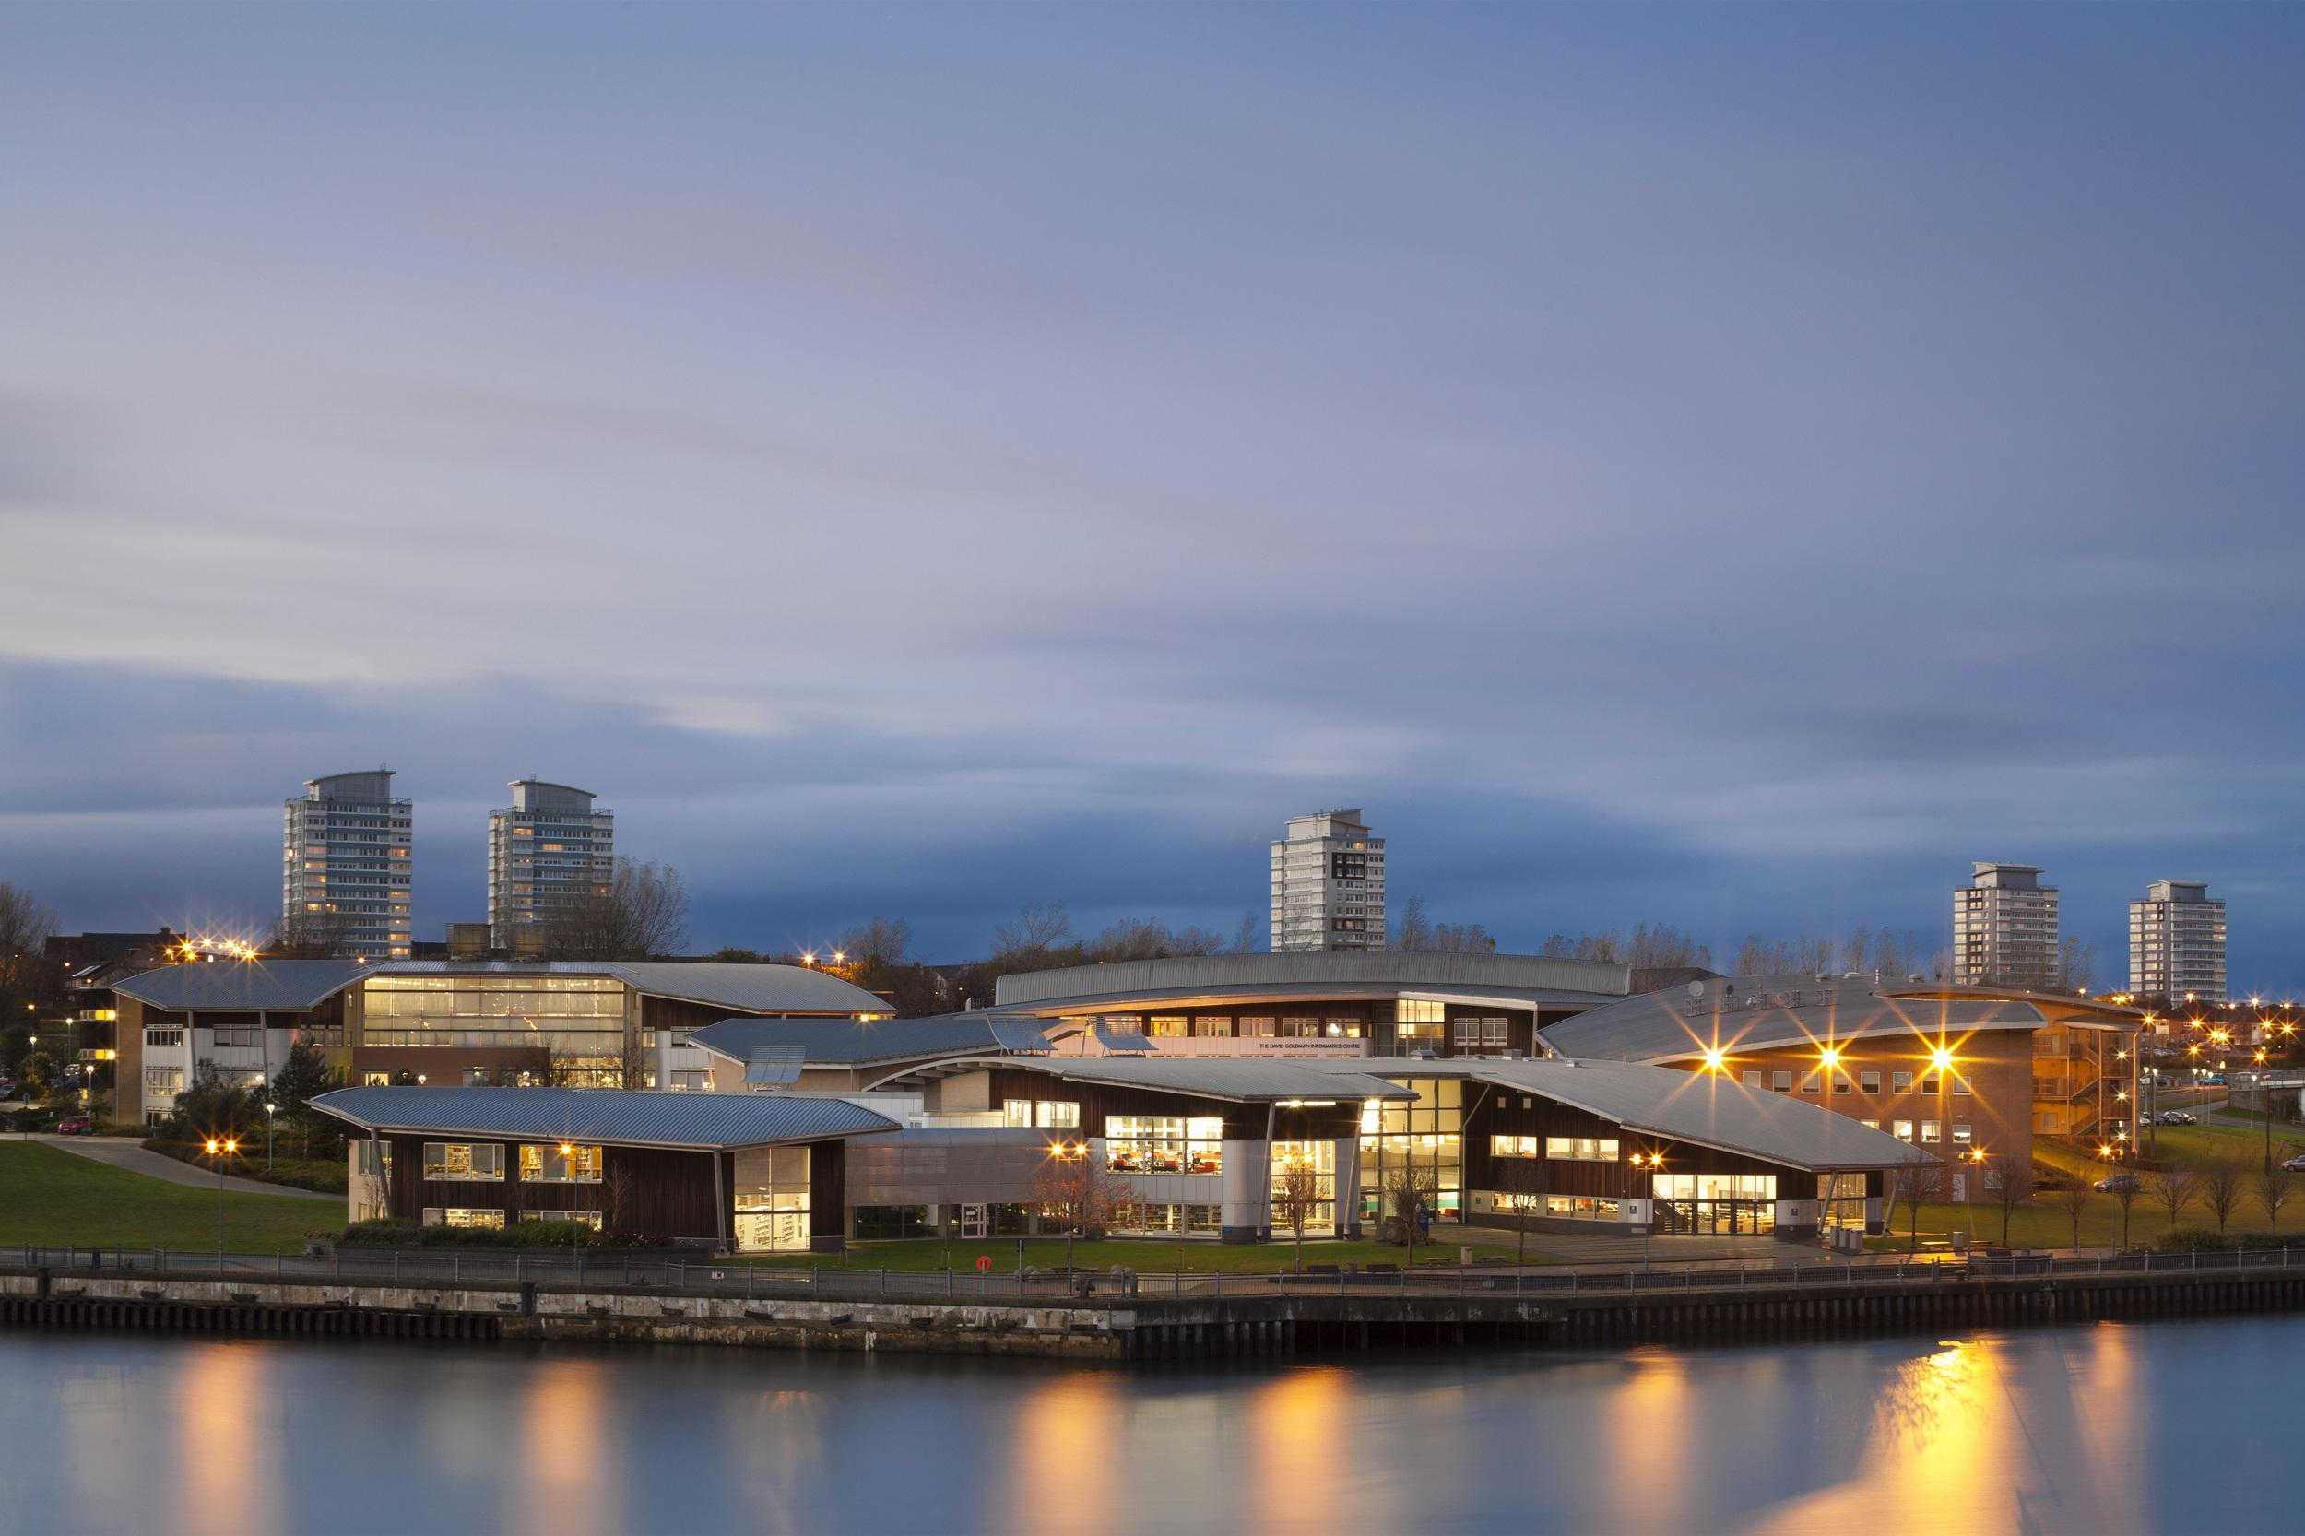
2nd International Practice Focused Research in Education Conference (IPFREC) 2023
Conference Theme: Research in Practice, in Further Adult and Vocational Education
Monday 3rd - Thursday 6th July 2023
St Peter’s Campus, Sunderland, SR6 0DD
For enquiries please contact:
Daniel Gregson: daniel.gregson@sunderland.ac.uk

Slide 25
Key References
Carr, W., (2005) For Education: towards critical educational inquiry, Buckingham: Open University Press.
Coffield, F., (2017) ‘An Open Letter to the New Chief Inspector : Let’s Make Ofsted a Force for Good’. Times Eductational Supplement , 21st January 2017.
Dewey, J., (1910, 1933). How We Think: Boston: Heath.
Dewey, J., (1916) Democracy and Education, New York: Macmillan.
Dunne, J., (1997) Back to the Rough Ground, Notre Dame, Indiana: University of Notre Dame Press.
Dunne, J., (2005) ‘What’s the Use of Education?’, in Wilfred Carr (Ed) Philosophy of Education , Abingdon, Oxon: Routledge. .
Elliott, J., (2001) ‘Making Evidence-based Practice Educational’, British Educational Research Journal, Vol. 27, No.5, pp.555-574.
Goldacre, B., (2010) Bad Science, Farrar, New York: Faber and Faber.
Gregson, D., Gregson, M. and Spedding, T., 2019, ‘Top-down and outside-in: Breaking boundaries between research, theory and practice in education’. Journal of Management Policy and Practice, 20(3), pp.36-52.
Gregson, M., and Spedding, T., (Eds). (2020) Practice Focused Research in Further, Adult and Vocational Education: Shifting horizons of educational practice, theory and research. London: Palgrave-Macmillan
Gregson, M., (2020) ‘In Practice’ , Journal of Education Sciences, Vol. 10 (4) 93
Kemmis, S., (2005) in W., Carr (Ed) For Education: towards critical educational inquiry, Buckingham: Open University Press.
Sarason, S., (1998) The Predictable Failure of Education Reform, , San Francisco: Jossey-Bass.
Sennett, R., (2008) The Craftsman, London: Penguin.

