Slide 1
#pullupachair
Lunch and Learn
Tweet: @blogsenco #pullupachair
Sarah Martin-Denham
Associate Professor of Care and Education
University of Sunderland
8/2/2023

Slide 2
Agenda ...
Welcome
The #pullupachair movement
Film and resource viewing
Discussion and next steps

Slide 3
The #pullupachair movement
Original research
55 conversations with CYP 5-16 years
Phase 1: #seeme #pullupachair2
10 CYP at the University of Sunderland
Phase 2: #pullupachair
130 CYP, 4 artists and a national exhibition of artworks
Phase 3: #seemesouth #pullupachair
15 CYP, artist in residence Frank Styles
Phase 4: #pullupachair
28 CYP, Theatre Director

Slide 4
The funders ...
• The University of Sunderland (UoS) Interdisciplinary Research Network: Adverse Childhood Experiences
• The UoS, Faculty of Education and Society, Discretionary Research and Knowledge Exchange Funding
• United Kingdom Research and Innovation (UKRI) Participatory Research Fund 2021-2022
• UKRI Policy Support Fund 2021-2022
Total cost of 4 projects: £27,997

Slide 5
The partners
Donna Walker and Nicole Hackett: The Link School, Sunderland
Denise Taylor and Lindsay Howells: Beacon of Light, Sunderland
Jake Vart and Johanna Butler: Hopespring
Dominic Gray: The Beacon Centre, South Tyneside
Kerrie Whelan: Endeavour Academy, Peterlee
Claire Blackett and Rachael Brown: Hurworth House School, Darlington
Rebecca Cross: River Tees Multi Academy Trust, Middlesbrough
Catherine Forster: The Bridge, Durham
Aileen Morrison: St Matthias, Bristol
Ruth Johnson: Theatre Director
Pav Gajek: Filmmaker
Ryan Graham: Graphic Design
Together for Children

Slide 6
Accessing the materials
Link: Adverse Childhood Experiences | The University of Sunderland
Register for EYFS/Primary and Secondary (or both)
Films 1-5 (EYFS/Primary) and films (6-9) secondary

Slide 7
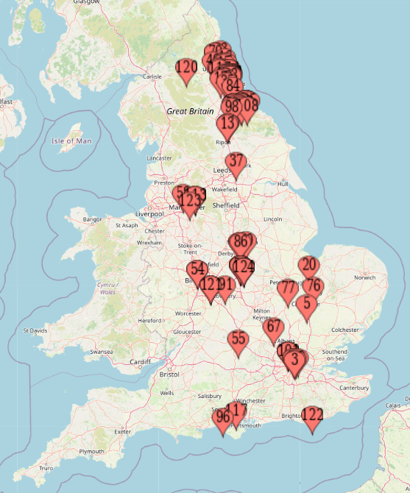
Reach ...
Local Authority SEND teams in England, schools, DfE, Charity sector, Queensland Government, Australia, TES
Other projects …
What works for Ukrainian Children
#pullupachairparents
Local Data Accelerator Fund
British Academy of Childhood Disability
PhD publication

Slide 8
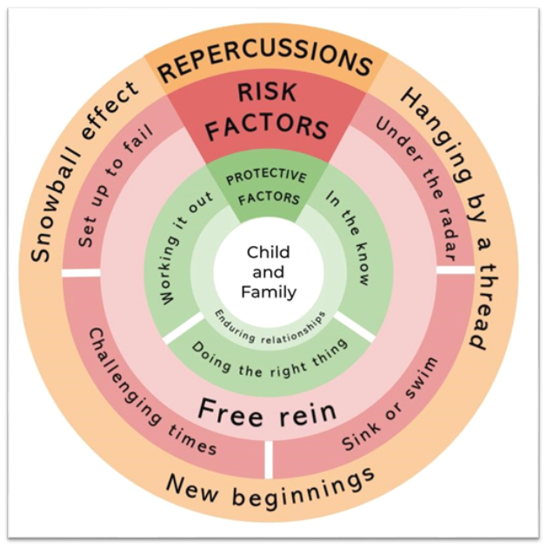
Protective
Enduring relationships. Sustained relationships seemed to buffer the adversities encountered. A sense of belonging comes with enduring relationships
In the know - knowledgeable staff who know and adhere to their legal obligations are important
Working it out - assessment and identification of SEND
Doing the right thing - recognising the need for and agreeing/applying reasonable adjustments. Providing SEN support, bespoke environments, flexible sanctions, school days and an offer of vocational

Slide 9
Q & A How can we work together?

