Slide 1
The Narrative Accounts of Thai Women Now Living in England Following Migratory Marriage
Dr Angie Wilcock

Slide 2
Introduction
The study,
Population
The labelling of the ‘Thai Bride’
Barriers – language, job opportunity, discrimination, isolation.
Discussion Time

Slide 3
The Study
A qualitative approach using semi-structured interviews, hard to reach sample - snowball approach - female Thai nationals living in England, employed via an advert on Thai community Facebook pages, LinkedIn, Twitter, Thai Online networks, local agencies and local businesses,
Thematic analysis - Nvivo, phase 2 - online survey being posted,.
10 Women participated , additional 4 dropped out – gatekeepers!
Age – 20s x 3, - 30s x 4 - 40s x 3
Years Married – 1 – 20yrs
Area of Thailand – Bangkok x 6 – Phuket x 2 – Isan x1 – Pattaya x 1
Education – Degree x 5 – (MSc x 3) - Secondary College x 2 – None x 3
Profession – Accountant, Banking, Architect, HR, Tourism (Management), Nurse, Masseurs.
Class – Middle x 4
.

Slide 4
Thai Population UK
Thai population in the UK in 2001 was 16,250
In England and Wales ONS (2011) identified Thai born nationals:
41,350 (more than doubled),
72% of those said to be women (ONS, 2011).,
42,673 (ONS, 2021).
The Home Office states that the vast majority of Thai people coming to the UK are given residence through migratory marriage (Simms, 2008; Charsley et al, 2011).
There are now student populations with around 6880 .(2021) studying in the UK.

Slide 5
Backdrop: Sex Tourism Industry
The sex industry, although it has a historical past within Asia became more apparent during the Vietnam war (see Esara, 2009), Thai Government sought to capitalise on it – contradictory as illegal.
This has resulted in it becoming a growing sex tourism hotspot for western tourists (Cohen, 2003), popular areas are Bangkok, Pattaya, Phuket, Chiang Mai, which is argued to exploit women for patriarchal leisure gain (Garrick, 2005).
Early literature suggests.Thai sex workers began to quickly recognise Bangkok as a city of western men, which could result in economic support (Jeffery, 2002).
For some this presented opportunity for marriage and a way out of the sex industry., as well as poverty. (Esara, 2009).
Led to agencies setting up and capitalising on the marriage of Thai women to western men – marriage bureau's and media representation of the ‘Thai Bride’ (Esara, 2009; So, 2006).

Slide 6
Transition
Women met their husbands online or through tourism in Thailand, three through work or study both in UK and Thailand.
Families raised concerns about their daughter leaving Thailand, more so those who identify as middle-class e.g.,
‘My mom said are you sure who is him blah blah blah especially when she knew we met online which she knows is dangerous and I said it is fine as I know I have worked abroad, and I can speak English’ [Mini].
Predominantly marriage was for a better life for economic reasons and education for children – intersectionality - class:.
‘I believe that university here better in the UK. and I want my son to have a good education better in than Thailand . In Thailand you have to pay a lot of money to go to education. All my friends they have to pay a lot of money, you know, for their kids, to be educated so staying here, we get good education and it's free‘ [Po].
I had to sacrifice my life (emotive), my job in Thailand for my husband and for my children to have a good education here and it is hard to fit in, you don't put your heart in it and then that becomes a problem’. [Onin]..

Slide 7
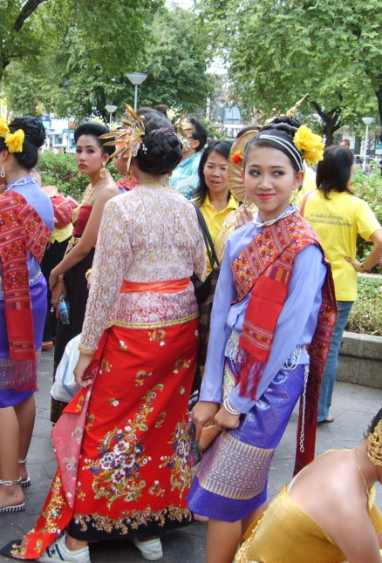
Intersectionality: Women’s Positioning
The women in the sample identified a class hierarchy within themselves:.
‘There two Thai groups though you know, like my group, which are married to UK husband because they met during their study. So, for that group I wish they could find, job and continue their life because a lot of them still had have to give up their career. With other group it's different story, so a lot of Thai people only focus on kind of, but like truck driver housewife… So, you know it's different support because for them it just about survival but for, for us we shouldn’t move from having career to being a housewife’. [Orraya]..
I trained accountant, worked for French and German companies through local government here in UK people think I am poor I marry rich man because I am poor Thai girl from Bangkok for money…. It’s that stigma [Beam]..
Regardless of this difference the women take on the domestic role in the home, take care of their husband and children, and some try and provide financially.

Slide 8
Cultural and Language Barriers
Level of English – Varied with not all women completing the English language test – loop-holes appear to exist!
‘I think language is very important, very important… When you first get here, if you don't know English then how do you get to A to B? How do you know what to do if you can't understand or read it’ [.Po].
Language – local accents very difficult, written English,
Family dynamics – cultural difference a struggle ‘We have agreement, if we marry we have to keep my family’ [Mini].
Finding friends – fitting in,
Food – bland, Thai stores,
Employment- qualifications/profession not accepted, take on domestic roles., dependency.

Slide 9
Discrimination
Presumed to have worked in the sex trade with all women having experienced derogatory connotations,.
‘And I know when out men say, are you from Thailand? Did you work in Pattaya? They're like, sleazy [Onin].
‘I had to leave my job in call centre, the men say I like Thai women how can we meet Thai ladies like you’? [Sue].
Presumed to be in England as ‘Thai bride’ for monetary exchange,
‘I get asked how much I charge’… [Beam]. ‘I have my husband's picture to stop men chasing me’ [Onin]. .
Isolation, mental health, enhances dependency, social alienation.

Slide 10
More To Be Done: Women’s Voices
‘I think educating husband might be also important because If people never relocate they don't understand what it is like to be in other culture’ [Po].
‘Support about English and support about the husband. I'm surely 99% or 95% like Asian people take husband, they don't like know their family. It's so different here so I think it should be like support with the family like and to understand that culture [Beam].
‘Every six months when you first come over (government) to check that everything is okay. And I think that's an issue as like, you know my friend for her (domestic violence) yeah, over 20 years she had no support, help and that's what we need’ [Ellie].
They (government/Thai Embassay) could set up official Facebook page with our basic rights, as we don’t know what they are and different to Thailand, have more rights with husband here’ [Onin].
‘I would love to go back to Thailand if I had a choice’ ... Also, some women do not know English as came before test, these women need help with English [Sue].

Slide 11
Thank You, Discussion Time!

