Slide 1
The experiences of Thai women following migratory marriage: ‘Just let us know our basic rights’,
Dr Angie Wilcock
University of Sunderland

Slide 2
Introduction
The study
Population
Sex tourism industry
Findings:
Discrimination,
Coercive Control,
Physical and sexual violence,
Tell us our rights, calls to change policy and practice.

Slide 3
The Study
Qualitative approach - semi-structured interviews, hard to reach sample - employed via an advert on Thai community Facebook pages, LinkedIn, Twitter, Thai Online networks, local agencies and local businesses.
Thematic analysis - phase 2 - online survey now posted.
10 Women participated , additional 4 dropped out – gatekeepers!
Age: 20s x 3, - 30s x 4 - 40s x 2, 50s x1
Years Married: 1 – 20yrs,
Area of Thailand: Bangkok x 6, Phuket x 2, Isan x1, Pattaya x 1,
Education: Degree x 5, (MSc x 3), Secondary College x 2, None x 3,
Profession: Accountant, Banking, Architect, HR, Tourism (Management), Nurse, Masseurs,
Class: Middle x 4.
.

Slide 4
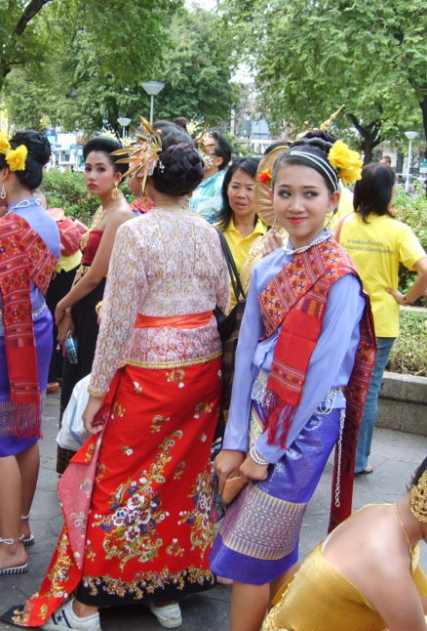
Thai Population
Thai population in 2001 was around 16,250
In England and Wales ONS (2011) identified Thai born nationals:
41,350 (more than doubled),
72% of those said to be women (ONS, 2011).,
42,673 (ONS, 2021).
The Home Office states, the majority of Thai nationals migrating to the UK are given residence through marriage (Home Office, 2011; Simms, 2008).
Student populations with around 6880 (2021) studying in the UK.
UK noted as having the largest Thai population in Europe (Chuenglertsiri, 2020)

Slide 5
Backdrop: Sex Tourism Industry
The sex industry, although it has a historical past within Asia became more apparent during the Vietnam war (see Esara, 2009).
This has resulted in it becoming a growing sex tourism hotspot for western tourists (Cohen, 2003), popular areas are Bangkok, Pattaya, Phuket, Chiang Mai, which is argued to exploit women for patriarchal leisure gain (Garrick, 2005).
Early literature suggests Thai sex workers began to quickly recognise Bangkok as a city of western men, which could result in economic support (Esara, 2009; Plambech, 2008).
Led to agencies setting up and capitalising on the marriage of Thai women to western men – marriage bureaus and media representation of the ‘mail order Thai Bride business’ (Esara, 2009; Liang, 2023; So, 2006).
Liang (2023) and Quek (2018) argue that commodifying women in this way contributes to the marriage trafficking market.

Slide 6
First Strong Theme: Discrimination
All women experienced derogatory unsolicited connotations relating to the sex industry and mail order bride:
‘The men mentioned to me, we like Thai girls, how can we meet Thai ladies? You're very pretty and I heard that Thailand the nightlife and the girls are very pretty. Some of them said they have been to Thailand and said like the tourism area, go, go club or something like that. Like they only see that part and I have the feeling that they imagine like, Thai, all Thai women are bar girls’ [Sue].
‘I'm quite struggling actually... (emotional) at work I'm just the one from Thailand and one of the guys had come to me and ask me are you from Pattaya? Yeah, Yeah, I know that he try to umm… make joke about me’ [Ellie].
Presumed to be in England as ‘Thai bride’ for monetary exchange, sexualised stereotyping;
‘I get asked how much I charge… and I know online friends have in the street’ [Orraya].
‘I have my husband's picture to stop men chasing me online’ [Onin] .

Slide 7
Domestic Violence and Abuse: Coercive Control
Coercive control is apparent in all relationships embedding gendered inequality, women took on the domestic role in all but one relationship:
‘My husband not want me to work he wants me to concentrate on bringing up the children here so being at home I am really lonely… but my husband bought properties and I clean and look after them for him and he moved his parents next door so I can help them [Onin].
Double Burden (Hochschild and Machung, 2012):
‘He take my money from business and when I bought car, he took my car and sold it for money as said I could not have it as his. I do everything in house and work like Thailand, look after husband’ [Nin].
Isolation was expressed by all women as husbands did not want them to have friends:
‘My father has given me money to study masters as my husband said he cannot pay, he thinks I should be happy with just him, not need anything else’ [Sue].
‘I asked my husband ‘where is my phone I need to call my friend’ he said, ‘I have not seen your phone then later I heard my phone, I heard a vibration from the bed and I said ‘but my phone is here somewhere’ but when he realised I could hear my phone he brought my phone out, he had took and hid my phone’ [Mini].
Patriarchy and gender inequality active - the women are subordinate and dependent on their husbands physically and emotionally.

Slide 8
Physical and Sexual Violence
Physical and Sexual violence was articulated by women who met their husbands online:
‘Err….about the 3rd or 4th year, he started shouting at me and he was more in a mood and stuff like that [emotional], he started to drink more… then problems started from then’ [Mini].
‘Not good things, first it was good but then he start angry with me after marriage, bad sex things and I have had operation to make me better’ [Nin].
Seeking help was not an option – fear of being sent home, financial implications and duty to their husband, unsure how to deal with it:
‘I nearly got my settlement visa so I need to wait about six or seven months, or a year and I did not want to have problems for him as well so I decided not to go there yet. The GP said you do not have to stay the organisation will help you with your visa as well and domestic abuse but must wait to be safe [Millie].

Slide 9
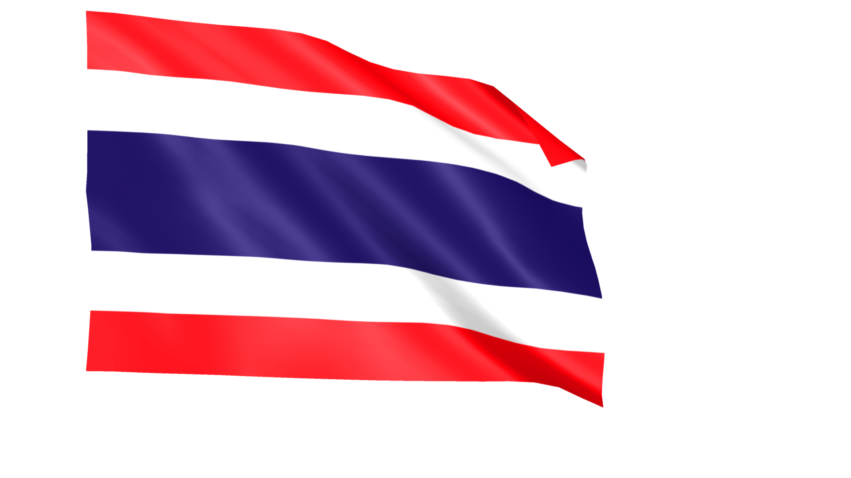
‘Tell us our rights’, challenges for policy
Support from the national and local government lacking, including immigration:
‘Thailand is communism country, we don’t have rights, but here we have basic rights and they should tell us our rights to protect ourselves’ [Kulop].
‘We have a community of Thai women who are who are being excluded, not integrated, not recognised for their value and what you can offer to the communities. I think we need to say what more can we do to dispel the myth of Thailand and integrate women's successfully into our communities’ [Arpa].
‘Government should tell us background of husband if sex offender. I googled him after someone said something to me (emotional)... He has porn and sexual things on his computer, we should be told’ [Mini].
All of the women are concerned about the number of women living in the UK and who are not visible in society, predominantly why they agreed to participation.

Slide 10
Thank You, Discussion Time!

Slide 11
Bibliography
Cohen, E. (2003) Transnational marriage in Thailand. In T.G. Bauer and B. McKercher (eds) Sex and Tourism: Journeys of Romance, Love and Lust. New York: Haworth Hospitality Press.
Esara, P. (2009) ‘Imagining the Western Husband: Thai Women’s Desires for Matrimony, Status and Beauty’, Ethnos, 74(3), pp. 403–426. Available at: https://doi.org/10.1080/00141840903053162 [accessed 20 June 2023].
Garrick, D. (2005) ‘Excuses, Excuses: Rationalisations of Western Sex Tourists in Thailand’, Current issues in tourism, 8(6), pp. 497–509. Available at: https://doi.org/10.1080/13683500508668233 [accessed 20 June 2023].
Home Office (2011) Marriage-related migration to the UK, Occasional Paper 96. Avaible from: https://www.gov.uk/government/publications/marriage-related-migration-to-the-uk [accessed 20 June 2023].
Liang, X. (2023) ‘Marriage Trafficking: Demand, Exploitation, and Conducive Contexts—A Study in China–Vietnam Border Areas’, Violence against women, 29(3-4), pp. 548–579. Available at: https://doi.org/10.1177/10778012221094064 [accessed 20 June 2023].

Slide 12
Bibliography
ONS (2011) 2011 Census analysis: Ethnicity and religion of the non-UK born population in England and Wales: 2011. Available from: https://www.ons.gov.uk/peoplepopulationandcommunity/culturalidentity/ethnicity/articles/2011censusanalysisethnicityandreligionofthenonukbornpopulationinenglandandwales/2015-06-18 [accessed 20 June 2023].
ONS (2022) Population by country of birth and nationality 2021. Available from: https://www.ons.gov.uk/peoplepopulationandcommunity/populationandmigration/internationalmigration/datasets/populationoftheunitedkingdombycountryofbirthandnationality [accessed 20June 2023].
Plambech, S. (2008) ‘FROM THAILAND WITH LOVE: TRANSNATIONAL MARRIAGE MIGRATION IN THE GLOBAL CARE ECONOMY’, Wagadu, 5, p. 32–.
Quek, K. (2018) Marriage Trafficking: Women in Forced Wedlock. London: Routledge.
So, C. (2006) ‘Asian Mail-Order Brides, the Threat of Global Capitalism, and the Rescue of the U.S. Nation-State’, Feminist studies, 32(2), pp. 395–419. Available at: https://doi.org/10.2307/20459093 [accessed 20 June 2023].

