Slide 1
Facilitated Practice-based Research ©University of Sunderland An Empowering Pedagogical Approach to Reframe Research Capacity in Social Work Practitioners
Presentation plan:
Bourdieu’s Field Theory, Facilitated Practice-based Research (FPR) – empowerment model, Lesley Deacon
Teaching FPR, Carrie Phillips
Participatory Action Research Methodology, Lesley Deacon
Participatory Action Research Project, Zeta Bikova
Findings, from Cohorts 1, 2 and 3, Lesley Deacon
Next steps, Lesley Deacon
Dr Lesley Deacon, Senior Lecturer in Social Work & VC’s Research & Knowledge-exchange Fellow
Ms Carrie Phillips, Senior Lecturer in Social Work
Ms Zeta Bikova, Lecturer in Health and Social Care
JSWEC Conference, Glasgow

Slide 2
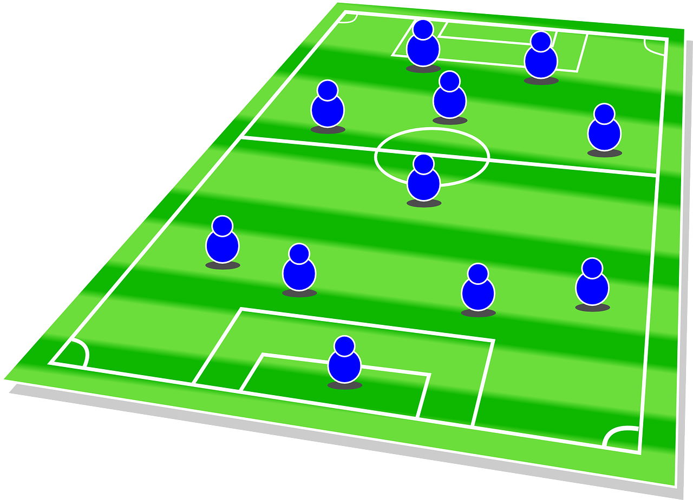
Research anxiety: application of Bourdieu’s field theory
LD
Field-specific struggles over power, success based on inherited or acquired capital.
Habitus – dispositions acquired by individuals as they operate in a particular field.
Field of social work research (Deacon, 2023, p.105), HEIs have:
Economic: more access to research funding.
Cultural: more further education options.
Social: more access to research networks.
Symbolic: HEI research seen as legitimate, language intellectualized.
BUT… Researcher Development Framework (RDF) devised based on empirical data to highlight ‘what makes excellent researchers’ (Vitae, 2022: 3, cited in Deacon 2023)
Comparison with SW skills/knowledge:
high level communication skills;
high level of subject knowledge;
Understand values and ethics; and
ability to assess and understand issues and devise plans.
‘Social work students, practitioners and educators have essential research skills and knowledge but do not possess the symbolic capital to reframe these in the field of social work research and are habituated into research anxiety’. (Deacon, 2023, p.102)
Notes:
Whilst there might be different ways to understand research anxiety in practitioners, in this piece of research, I applied Bourdieu’s field theory to understand how that research anxiety might emerge, and how it might manifest itself.
And in using Bourdieu’s field theory, we can see that fields relate to areas where there are specific struggles for power and success within those fields are based on inherited or acquired capital.
And according to Bourdieu, habitus referred to the dispositions that are acquired by individuals who work in those fields.
So if actually we apply that to the field of social work research, what I would argue from the research that I've conducted so far is that within this arena, certainly relating it to the context in the United Kingdom, Higher Education Institutions (HEIs) have more access to research funding than practitioners do within practice environments. They also have, through their Research Excellence Framework (REF) outputs, that can then lead them to have even more access, so the higher rating they get within that then the more access they get to funding
In terms of their cultural power, HEIs, have more education opportunities for staff within them. So for example, you know at the university where I'm working currently, staff have had access to free PhDs, those who haven't had them have been able to have their fees waived and studied within the university. Which is not something that's necessarily available as easily to practitioners.
In terms of the social capital of HEIs they have more access within networks. So for example, this conference at the minute this is presented an absolute amazing opportunity for my colleague, Paige, to present and to meet people, but that's not normally something that's available to practitioners within the UK who are actually active in practice at the same time.
In terms of the symbolic power. HEIs, certainly within a UK context, the research conducted from an academic perspective is seen as legitimate and the language of that study is legitimized through its intellectualization. For example, concepts such as ontology, epistemology. So the philosophical elements of research mean that there's a certain language that's applied to what legitimate research is, it looks at.
So what I argue with this, and yes, I know there are many different ways in which this could be perceived. But from this concept in applying Bourdieu’s field theory it means, that I would argue that social work students and practitioners and educators actually are socialised this position of research anxiety through these field struggles they position themselves as not researchers, as research being as something that’s separate to what they do as practitioners and that this manifests as research anxiety that then permeates throughout their experiences of research even if it is directly related to their practice.

Slide 3
Facilitated Practice-based Research (FPR) ©University of Sunderland
LD
Aim of FPR is to facilitate practitioners to reframe their skills as research skills (Deacon, 2023, p.102)
Facilitated Practice-based Research
FPR
FPR is an empowerment model designed by Dr Lesley Deacon, in collaboration with the Wallsend Children’s Community (WCC), to teach participatory research to practitioners, in action, within practice. (Deacon, 2023)
The approach assumes practitioners already have research skills and knowledge that they use every day in their practice e.g. investigating problems to understand them and develop intervention strategies.
The aim of FPR is to support practitioners to see these links and reframe their skills and knowledge, thus developing their research capacity.
Notes:
So this is the model that I've devised based on my Participatory Action Research Project, and it's called, and I've named it and copyrighted it to the University of Sunderland, Facilitated Practice-based Research, and the facilitated element is a really important part of that. It's very much an empowerment model, so it's based on addressing the research anxiety and empowering practitioners to support them in developing their research skills in action and in practice. So there are certain elements of assumption within this model which is that it's actually based on the idea and of Bourdieu’s theory, that actually practitioners already have research skills and knowledge. They use them every day in practice, but they don't know how to name them, and they don't know how to identify them as research.
So the model’s aimed at supporting practitioners to see the links to reframe their skills and knowledge as research rather than just practice. So that actually they're sort of empowered then into doing research themselves within practice environments.

Slide 4
Reframing Practice as Research
CP
Assessment skills?
Reading the case file?
Writing a report?
Semi-structured interview?
Literature review?
Writing a report!
EXAMPLES
Bravery
Professional curiosity
Learning by doing
Reducing anxiety
Putting research into practice
Evaluating outcomes
Sustained transformation
OUTCOMES
Notes:
Across different cohorts, we have stressed the skills that research and social work have in common – for example drawing parallels between assessment skills and semi-structured interviews; reading the service user’s file as being like a literature review, or writing a court report as compared to a research report. Most practitioners had not thought about this before, and some reflected that they had not been taught research in this way during their social work education – they had seen research as quite separate to practice – something that you might refer to in order to understand or intervene, but not conceiving research as a broader branch of professional curiosity.
The other thing that struck me, as someone new to practice-based research, was how brave the questions practitioners were asking were. When given free-reign to ask anything, they were asking some really probing questions about whether things really worked in the way they hoped they did (for example, when a parent consents to Early Help, is this informed consent or is it to some degree ‘coerced’? When we support NQSWs, are the models of support really effective in developing competent and confident professionals?
So the intention of the FPR model and what it's aimed at doing is that it's it suggested that… really that practitioners learn better through doing so. They learn through action. So by going out into the practice environment, doing the research together, they see the research constricted from literally nothing, to the ideas of what the research might be about, to then how we actually go about that, how we might answer the questions that we have implementing it in terms of gathering the data, analyzing the data and then producing a report at the end of it. So they very much do this research in in action and through this through being involved in this research project from prior to its conception, all the way through and completely involved, in that. They developed their research capacity through being able to see this process in action. And I would argue that this actually has the potential to alleviate elements of that research anxiety, because they then see for themselves what they can do and what research looks like all the way through, but within a practice environment. So not as something that's separate or outside of practice, but actually in practice with them. And that's why it's an important element of myself and colleagues from the university who actually go into these practice environments and sit with practitioners.
So the piece of practice research itself is based on actually their practice. Whatever they see is coming up as an issue. We come up with a decision as a group, but as to what we're gonna focus on and it's then put into practice so that impact can be actually established. They can then put things in place to address the issue or they can, through developing their research skills, implement new areas of research to perhaps look at an issue in more depth. And so again, this is developing their research capacity. What I want to emphasize with that, though it's an intensive program, it's not a quick fix and I know that my colleague Paige will share some of your own personal experiences around the journey that she's been on. It's not quick and it's not overnight. It's part of a journey that people go on in order to transform their feelings and knowledge around their research.

Slide 5
Participatory Action Research (PAR) Methodology
LD
FPR has been evaluated through qualitative PAR: how can we bridge the gap between social work research and practice?
There are five stages to this study, where FPR is implemented and evaluated in different settings and with different practitioners.
1. Small Charitable Organisation – support for children and families in areas of high deprivation, in person
2. Small Charitable Organisation – support for youth homelessness, online
3. A Local Authority – children’s services practitioners, online
4. Three Local Authorities – children’s and adult services practitioners, in person
5. In planning stage but aimed at 12 Local Authorities and a mix of children’s and adult services practitioners, in person
Research Associates:
Zeta Bikova
Emma Aggar
Notes:
And finally, for my part of the presentation, I just want to emphasize… I've mentioned that I've done participatory action research and what this is, is that in order to establish the effectiveness of the FPR program, what I've done is actually evaluated it constantly through Participatory Action Research. And the question was: how can we bridge the gap between social work research and practice? And so with that, I then, through collaborating with community organizations and also through local authorities.
I’ve devised and implemented this program and through then the evaluation that's given from those who have participated, or the practitioners themselves have then fed back into the process so that the model’s being adapted before I then named it… It's been continually adapted in order to address some of the issues with it to make sure that it is effective.
And as you can see, there are five stages to this project. So the first was with this, a small charity organization who support children and families in an area of high deprivation, and I did that in person. Another small charitable organization who support young homeless people and that was actually conducted online, so that I could test the differences between the in person elements and the online elements. That actually took place during our COVID lockdown, so there was a necessity element to that. I then have implemented this directly with frontline practitioners at children's services in a local authority. That was done online because of geographic regions, because we don't live near each other. And the 4th cohort is actually with a big group… with a range of children's and adult’s services practitioners in order to see how we can then co-construct a piece of research to go across all of those areas, as the practitioners develop their skills. And that's being conducted in person with my colleague, Paige is the part of that cohort. So she's going to be sharing her experiences along with the findings of this participatory action research. And the final stage is in planning at stage at the moment we're going to expand on stage four and try it across a bigger group of local authority practitioners. We're actually extending the region that it's going to cover and we believe we're going to do this in person; that's the plan at the moment.
What I've done in terms of the data collection for this is that there are qualitative focus groups conducted following the teaching program on each of these. These are actually gathered by a research assistant because obviously I do the teaching on this program and therefore I don't want to be directly involved. So they… I have a research assistant who does the focus groups, does the data analysis and then that only gets shared with me once the analysis is complete.
So the data that's gonna be shared today is from the first two cohorts with the charity organizations and also as I've said, my colleague Paige, who you'll look forward to listening to now, is gonna share with you her own personal experiences as a practitioner who's going through this process at the moment.

Slide 6
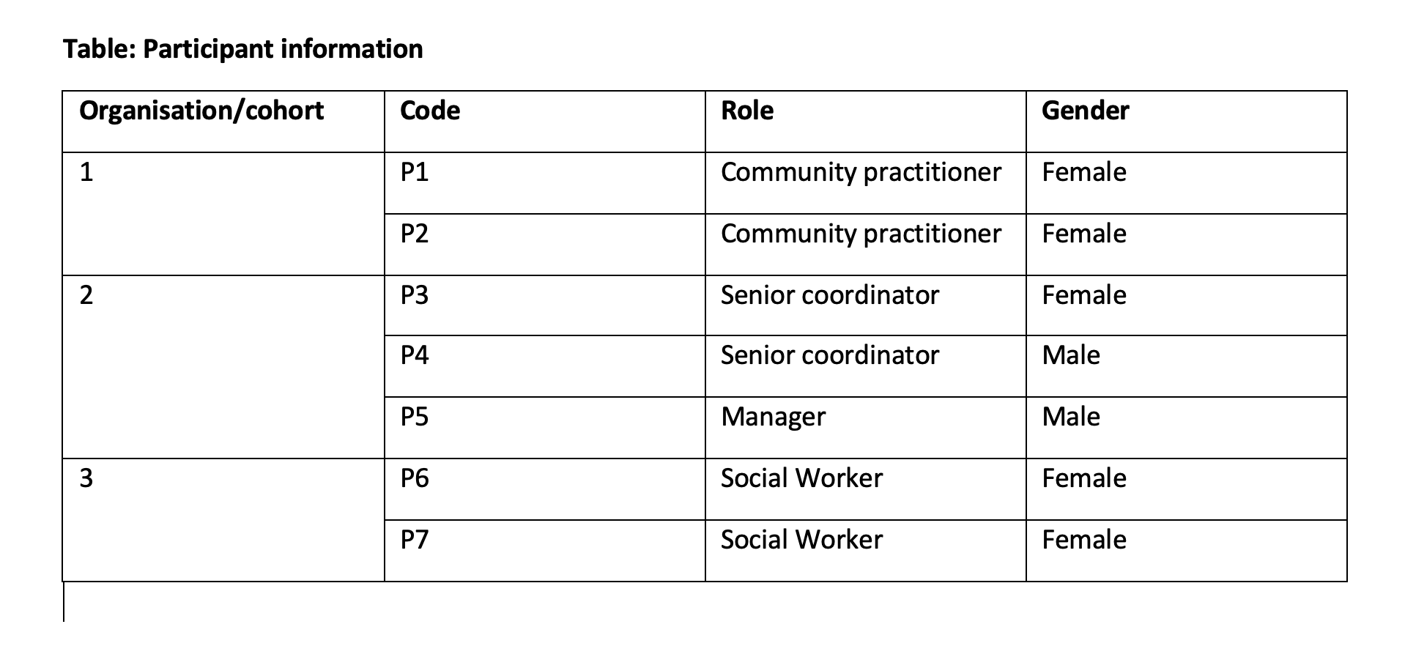
Methods
Qualitative focus groups (n=7):
Cohort 1 – non-moderated recorded focus group
Cohort 2 – moderated recorded focus group (ZB)
Cohort 3 – moderated, recorded semi structured interviews (ZB)
Transcript data thematically analysed
Data shared for these cohorts.
Ethics
Cohort 1- 008601, February 2021
Cohort 2- 011989, March 2022
Cohort 3 –013287, July 2022
ZB
This Photo by Unknown Author is licensed under CC BY

Slide 7
Self-reported Findings suggest:
1.
I was a bit apprehensive about the research training, P3
I have never liked research; I find it very dry and annoying because of all of the processes you have to do, P4
You need to have confidence in your own ability to do it, as it can seem massive, P1
LD
practitioners do habituate research anxiety;
they can conduct research but name it differently; and
their research confidence needs development, through recognising it and beginning to name their work as research.
3.
The … terms are not naturally there in our heads. It is only on reflecting back now that you realise you have done everything point-by-point right, P2
It certainly made me more confident in carrying out…research P6
I really do think I gained a lot from this programme… I wish I did [it] before my Masters. P7
Deacon, 2023, p.112
Notes:
Examples in bubble
Table shows terms
Early in the journey, P1 would refer to analysing feedback as what people were “talking about”. On completion of the programme, they were able to identify this as “thematic analysis” and, going forward, used that term in practice reports.
As their confidence increased, so did their research capacity, and they were better prepared when research terminology was slowly reintroduced by the facilitator.
Deacon, 2023, p.113

Slide 8
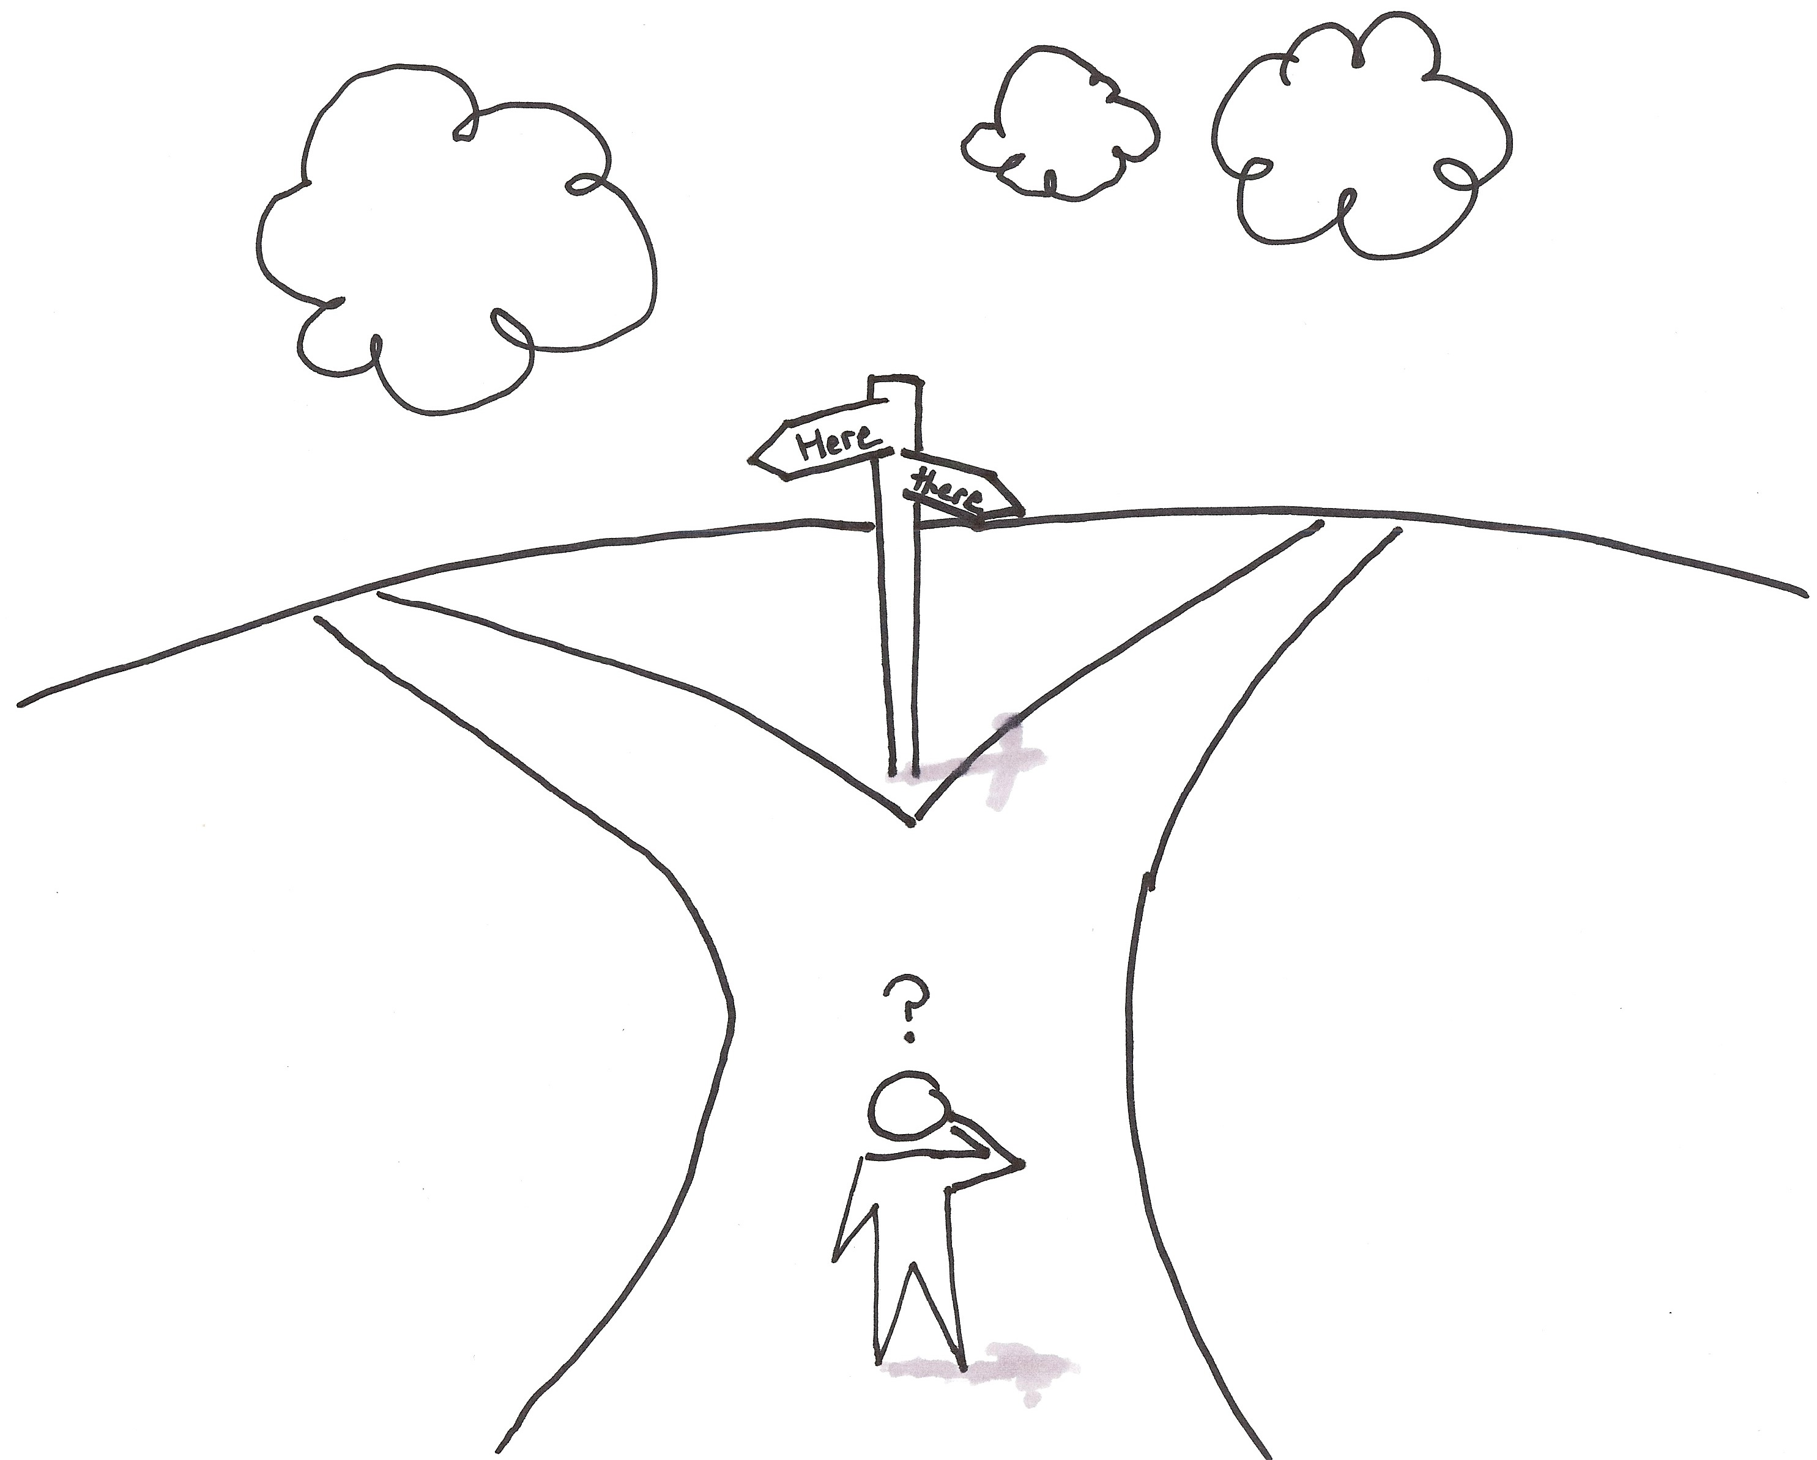
LD
But… the journey to research confidence takes time
not a quick fix but about sustained transformation
NEXT STEPS
FPR programme :
Cohort 4, in data collection stage.
Cohort 5, last of the evaluation stage to begin in September 2023.
Data to be shared in publications and conferences from cohorts 3, 4 and 5.
Development of Practitioner Researchers, taking the approach to Skills for Care, BASW, Social Work England and NIHR.
Research Projects from Cohort 4:
This Photo by Unknown Author is licensed under CC BY-SA

Slide 9
Any questions
Thank you for listening!
If you would like to be involved,
please email:
Lesley.deacon@sunderland.ac.uk
Carrie.Phillips@sunderland.ac.uk
Zeta.bikova@sunderland.ac.uk
This Photo by Unknown Author is licensed under CC BY

Slide 10
Bibliography
ARTICLES
Deacon. L. (2023) ‘Facilitated Practice-based Research: A model of Empowerment to Reduce Research Anxiety in Social Work Practitioners and Reframe Cultural Capital, European Journal of Social Work Research, inaugural issue 1(1), pp.102-117.
Deacon, L. (2022) ‘Emancipatory Practice Development in Social Welfare Service Evaluation – a worked example’, International Practice Development Journal.
CONFERENCES
Deacon, L., Phillips, C. and Bikova, Z. (2023) ‘Facilitated Practice-based Research: An empowering Pedagogical Approach to Reframe Research Capacity in Social Work Practitioners’, JSWEC Conference, Glasgow and FES Conference, University of Sunderland
Deacon, L. and Lonbay, S. (2023) ‘Narrowing the Gap between Social Work Research and Practice: how social workers make use of research and what impact does it have on practice?’ European Conference for Social Work Research, Milan, Italy.
FORTHCOMING
Deacon, L. (forthcoming) ‘Facilitated Practice-based Research: A Trauma-informed Pedagogical Approach to Reframing Research Anxiety to Build Research Capacity in Social Work Practitioners’

