Slide 1

Exploring the causes of health inequalities in disadvantaged areas of Sunderland
Robyn Jones, PhD Researcher
Robyn.jones-1@sunderland.ac.uk

Slide 2
PPI sessions
Shaped the study design and materials used.
Included a representative sample of participants.
Pilot Study
2 Focus-Groups
21 Participants
Main Study
Findings
Evaluated feasibility of study plan.
Thematic Analysis
Informed main study
27 Individual Interviews
5 Focus-Groups
21 Male – 31 Female (52 participants)
Age range: 18-77 (49.2)
Straussian Grounded Theory and Situational Analysis
7 categories; 14 sub-themes
One central category
Ethical approval granted by the University of Sunderland

Slide 3
“Where you live matters”
The impact of financial deprivation
Issues in access and quality of services
The impact of loneliness, social isolation and negative relationships
The long-lasting impact of early life experiences.
(Un)Employment and health
Experiences of stigma

Slide 4
Housing as a pillar of health and well-being
Compositional and contextual factors of area of residence
Impact of financial deprivation: “it is a knock-on effect”
Financial strain, accessibility of basic needs, and health related behaviours.
Access and quality of health care services
Access and quality of welfare services
Digital inequality
Loneliness, lack of support, and social isolation.
“The wrong kind of support around you”
The impact of aspirations.
The impact of workplace discontent and job instability on health and wellbeing
Impact of unemployment on health and wellbeing
Perspectives on work and welfare benefits: dilemmas of incentives and stability
The impact of stigma on help-seeking behaviours.

Slide 5
Central findings: The importance of stability and security.
The thesis understands stability and security to be concerned with the “basics”, involving stable, predictable, and safe living conditions and support.
 | Stability | Security
Objective | The observable presence of consistent and predictable satisfactory living conditions in key areas such as income, housing, relationships, and employment. | The measurable external conditions which ensure protection from harm in various forms, including income level, employment, safe housing, and access to basic services.
Subjective | One’s internal sense of perception of consistency and predictability in life, where they feel confidence in living conditions to be stable, underpinned by a sense of routine, predictability and structure. | One’s internal perception or feeling of being protected and safe from threat or harm, where there is an absence of feelings of fear and vulnerability.

Slide 6
Central findings: the importance of stability and security.
Matters of stability and security were commonly discussed in parallel during interviews.
The relationship between stability and security could be considered bilateral; whilst security can contribute to stability, stability can also foster security.
Security in key areas of life allows individuals to feel more stable in life, due to feeling less likely to face sudden disruptions, whilst also allowing people to feel more equipped to overcome any challenges.
Stability in key areas can help create a sense of security, due to a reduced risk of unforeseen sudden life shifts.
Security and stability could enhance one another, making people feel less at risk of unforeseen challenges, and more equipped to deal with these if they do occur.

Slide 7
Central findings: The importance of stability and security.
Objective and subjective instability and insecurity
Unemployment and job insecurity
Lack of stability and aspirations in early life
Issues in access and quality of welfare and healthcare services
Lack of financial stability and security
Unstable housing and neighbourhoods
Lack of perceived support and
“sense of community”

Slide 8
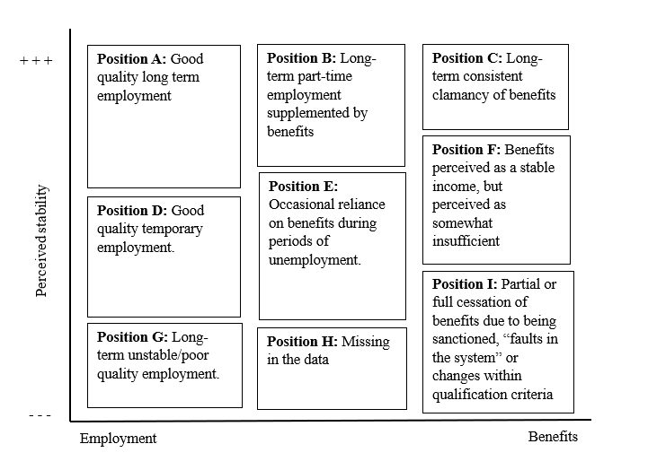
Instability and a lack of security as a potential driver of decision making

Slide 9
Reflecting on the Healthy City Plan 2025 refresh.
“When the building blocks are weak or missing, living a healthy life becomes significantly more difficult”
“[…] for too many people in our city these blocks are crumbling or missing altogether”
Building blocks = What health depends on
Stability and security = how strong and reliable these blocks are and how firmly they are connected.
If the blocks are there, but are in poor condition, not stacked well, missing mortar between them, or we fear them to be taken away, stress, worries and anxieties may come flooding, especially when we feel as though we do not have the resources or support to repair or replace these.
However, even when offered a “new brick”, if it is not perceived as more secure and stable than the one we already have, even if it is in poor condition, we might prefer to keep what we have rather than risk replacing it with one that is weaker of less reliable.

Slide 10
Developing recommendations: informed by PPI.
Two PPI sessions took place.
These were used as an opportunity to both verify the interpretation of the findings and develop recommendations for the thesis.
The feedback and discussions had during the sessions shaped the following recommendations.

Slide 11
Recommendations
The recommendations aim to improve both the actual conditions and the personal feelings of stability and security for Sunderland residents.
Existing interventions already address some aspects of instability, especially in areas like housing and employment.
The recommendations seek to strengthen and prioritize efforts that enhance people's sense of security and stability.
They do not propose entirely new interventions, but instead, they emphasize the importance of embedding empathy, personability, accessibility, and community partnership into service design and delivery.
Recommendations are divided into two areas.

Slide 12
Key area 1
Acknowledge and enable voluntary and community organisations as key partners in delivering community centred and driven approaches to tackle health inequalities.
Treat local community and voluntary organisations as important partners in enabling communities and tackling health inequalities. | Offer tailored support to the organisations themselves to allow them to reach their full potential in providing sufficient, consistent, and reliable support. | Seek regular feedback from the organisations and their users to ensure interventions are efficient and continue to reflect and address community priorities and needs. | Help spread awareness of how community and voluntary groups can offer support, so more people know about them and can benefit from the support they offer.

Slide 13
Key area 2
Develop empathetic services tailored to communities’ lived experiences and circumstances with particular attention to addressing instability and insecurity in key areas of life.
Co-develop pathways to access support services which are tailored to communities’ abilities and preferences to make support easier to reach and navigate. | Co-develop training with local voluntary and community organisations which aims to ensure health and welfare services offer kind and personalised support, which is based on a real understanding of community needs and delivered in a way that respects their experiences and concerns. | Support service users to understand that even helpful changes can feel unsettling or risky for some people, which may require a higher level of understanding and support. “Staff-training on how perceptions of stability and security can shape users’ risk perception and decision-making”

Slide 14

Discussion and questions
What do you think about the recommendations?
What is already in place?
What suggestions would you make to improve the recommendations?
Do you have any further recommendations in mind?
How could these recommendations align with the Healthy City Plan refresh and the recently published 10 Year Health Plan for England?
Please feel free to ask any questions during this session, or by sending an email to robyn.jones-1@sunderland.ac.uk

Slide 15
Acknowledge and enable voluntary and community organisations as key partners in delivering community centred and driven approaches to tackle health inequalities.
Treat local community and voluntary organisations as important partners in enabling communities and tackling health inequalities. | Offer tailored support to the organisations themselves to allow them to reach their full potential in providing sufficient, consistent, and reliable support. | Seek regular feedback from the organisations and their users to ensure interventions are efficient and continue to reflect and address community priorities and needs. | Help spread awareness of how community and voluntary groups can offer support, so more people know about them and can benefit from the support they offer.
Develop empathetic services tailored to communities’ lived experiences and circumstances with particular attention to addressing instability and insecurity in key areas of life.
Co-develop pathways to access support services which are tailored to communities’ abilities and preferences to make support easier to reach and navigate. | Co-develop training with local voluntary and community organisations which aims to ensure health and welfare services offer kind and personalised support, which is based on a real understanding of community needs and delivered in a way that respects their experiences and concerns. | Support service users to understand that even helpful changes can feel unsettling or risky for some people, which may require a higher level of understanding and support. “Staff-training on how perceptions of stability and security can shape users’ risk perception and decision-making”

